Slide 1
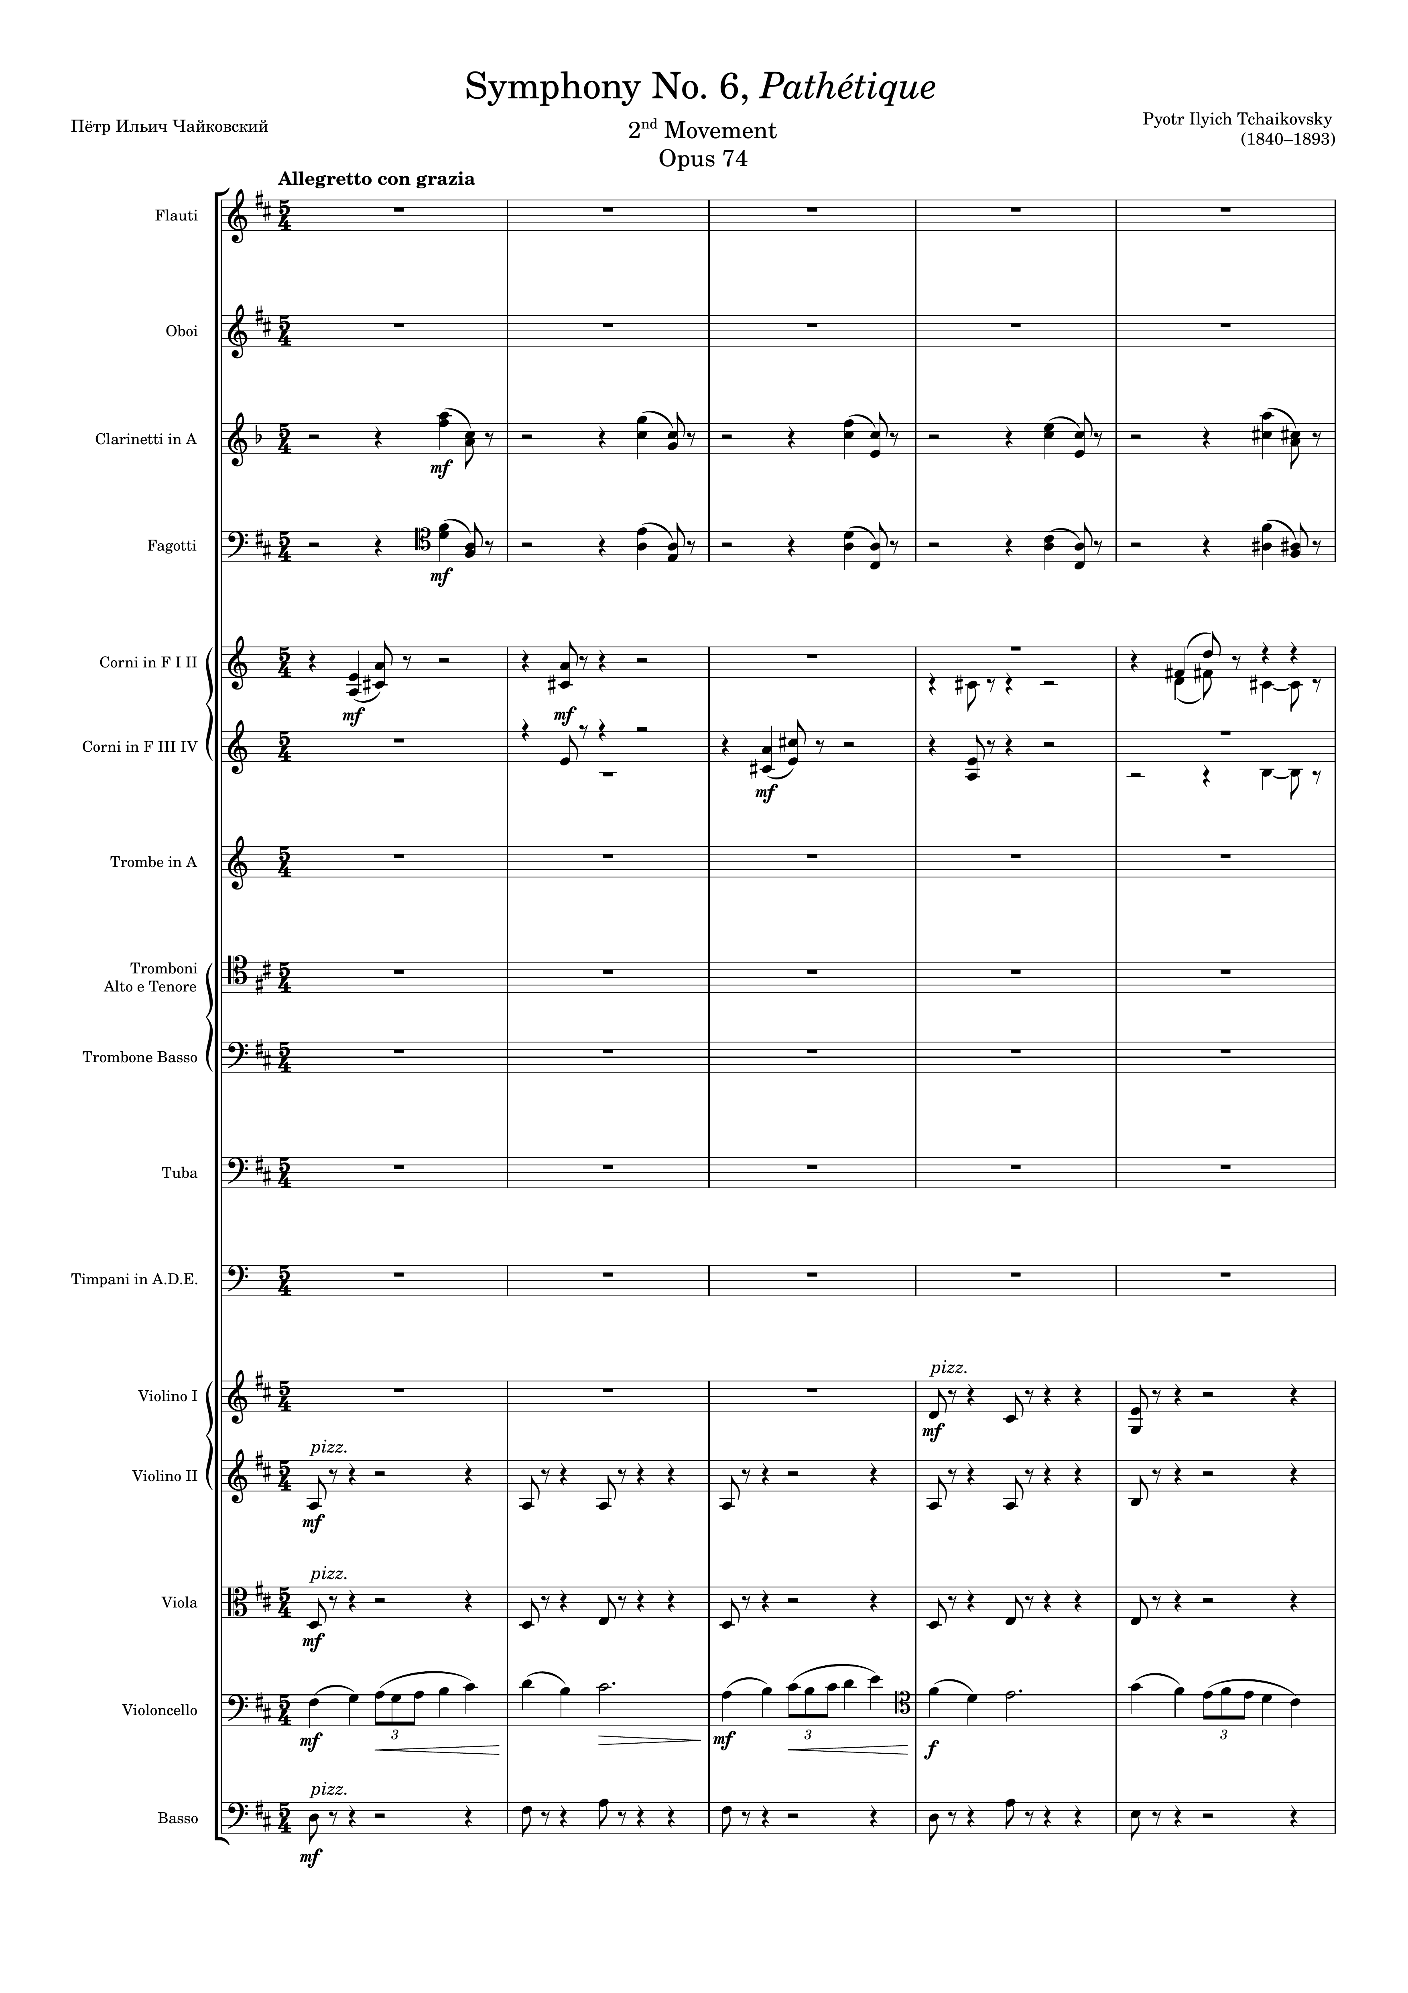
harm
harm
harm
harm
harm
rhythm
rhythm
mel
mel+rhythm
harm

Slide 2
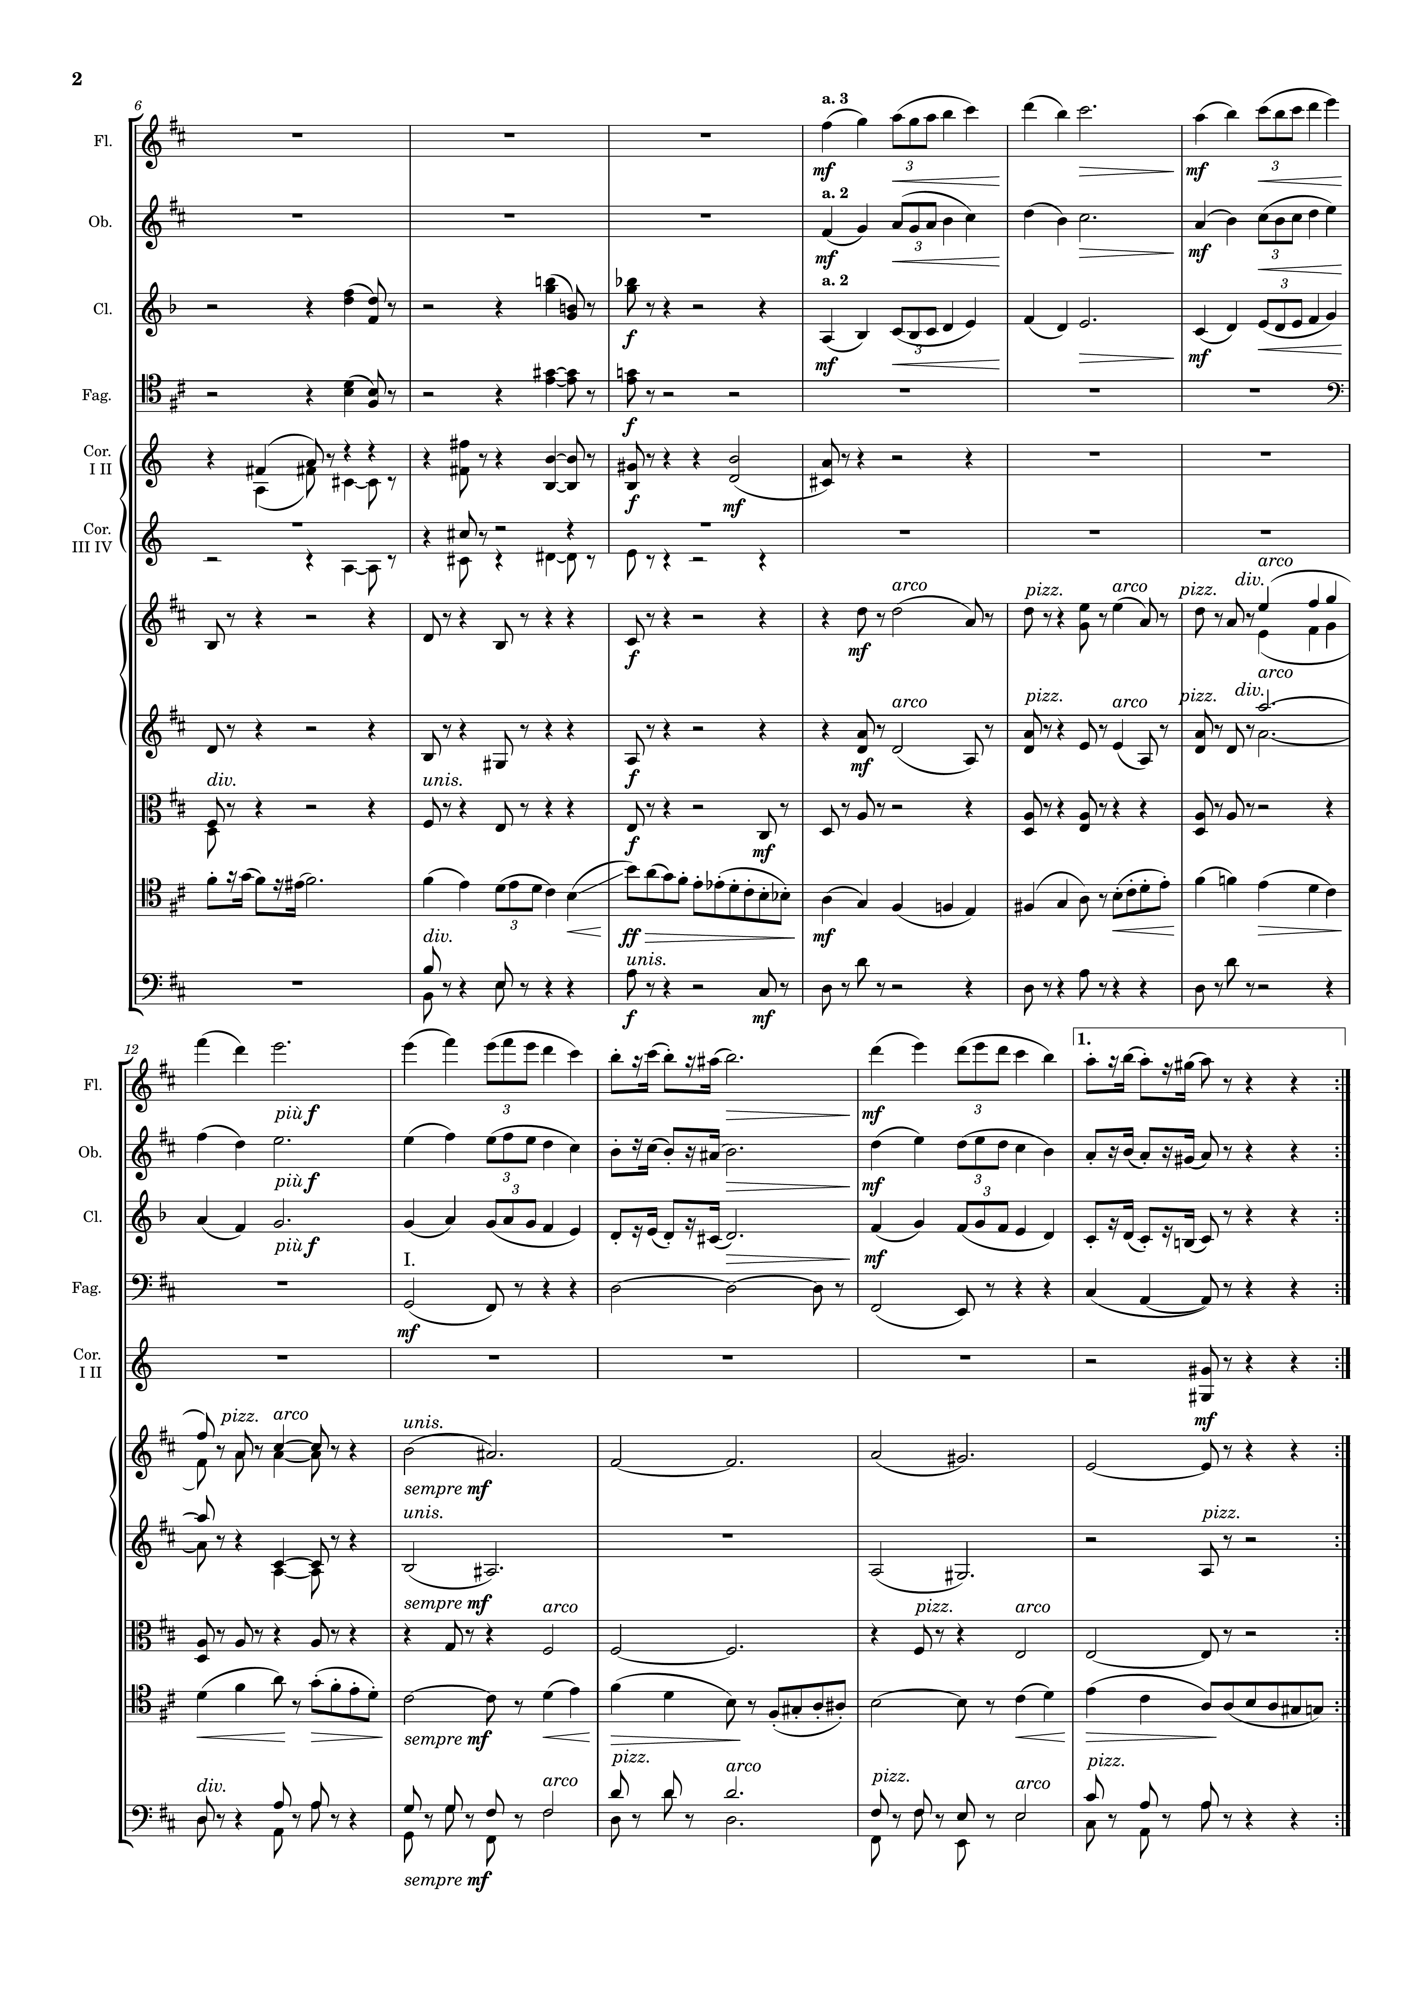
mel
mel
harm
mel
harm
harm
harm
harm
harm
harm
mel+rhythm
mel
harm
harm
mel
mel+rhythm
mel
mel+rhythm
mel
mel+rhythm
harm
harm
harm
harm
harm
harm

Slide 3
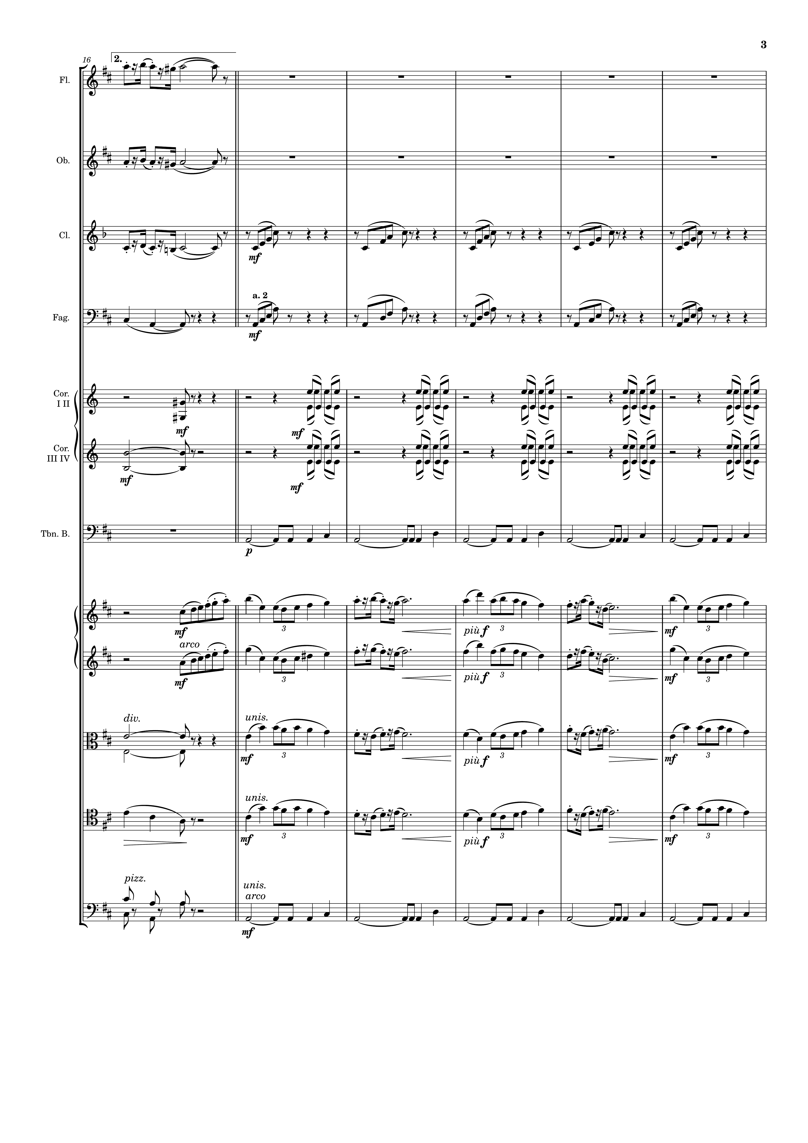
mel+rhythm
mel+rhythm
mel+rhythm
rhythm+harm
harm
rhythm+harm
harm
rhythm
harm
rhythm
harm
mel+rhythm
mel+rhythm
harm
rhythm+harm
harm
rhythm+harm
harm
harm

Slide 4
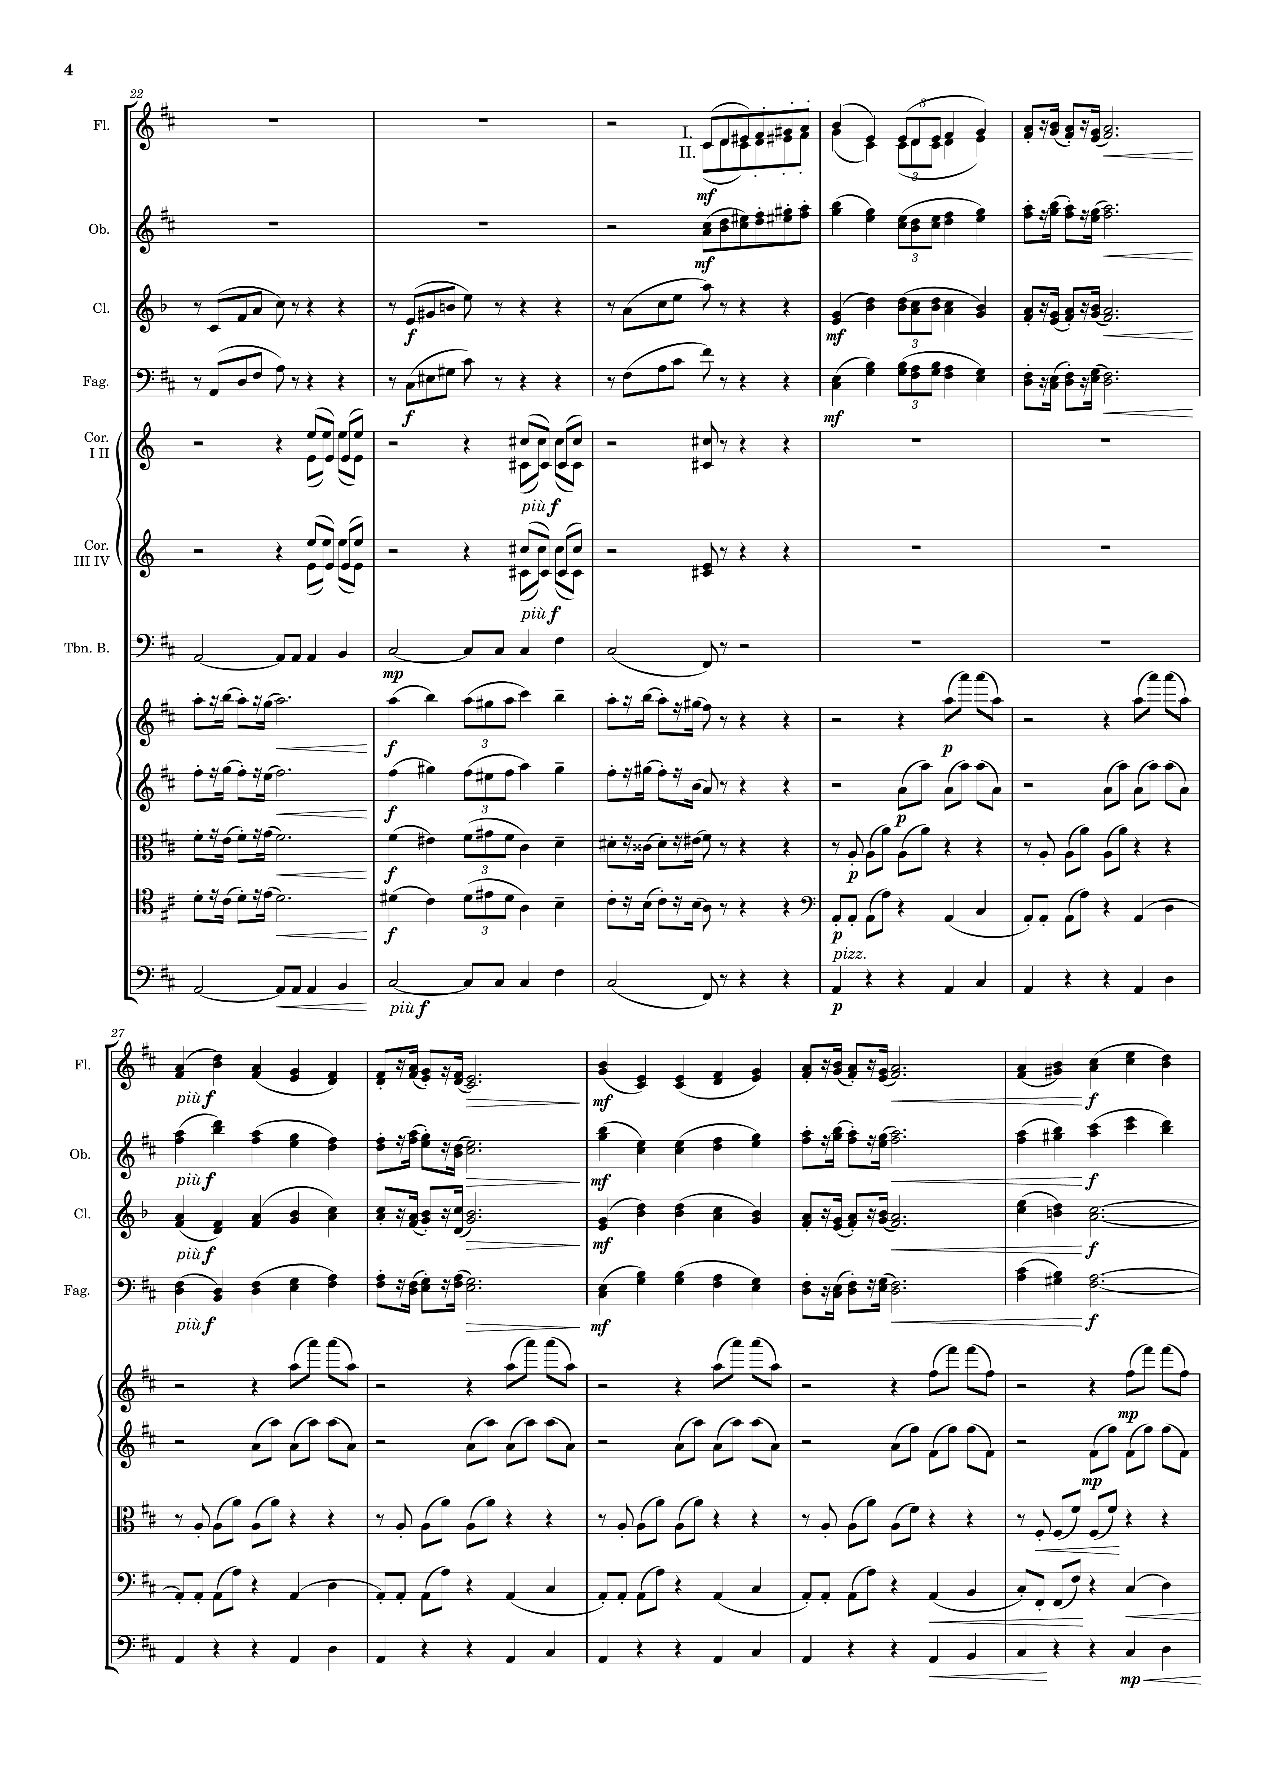
mel+rhythm
mel+rhythm
rhythm+harm
rhythm+harm
rhythm
rhythm
harm
mel+rhythm
rhythm
mel+rhythm
rhythm
rhythm+harm
rhythm
rhythm+harm
rhythm
harm
rhythm
mel+rhythm
mel+rhythm
rhythm+harm
rhythm+harm
rhythm
rhythm
rhythm
rhythm
harm
rhythm
harm

Slide 5
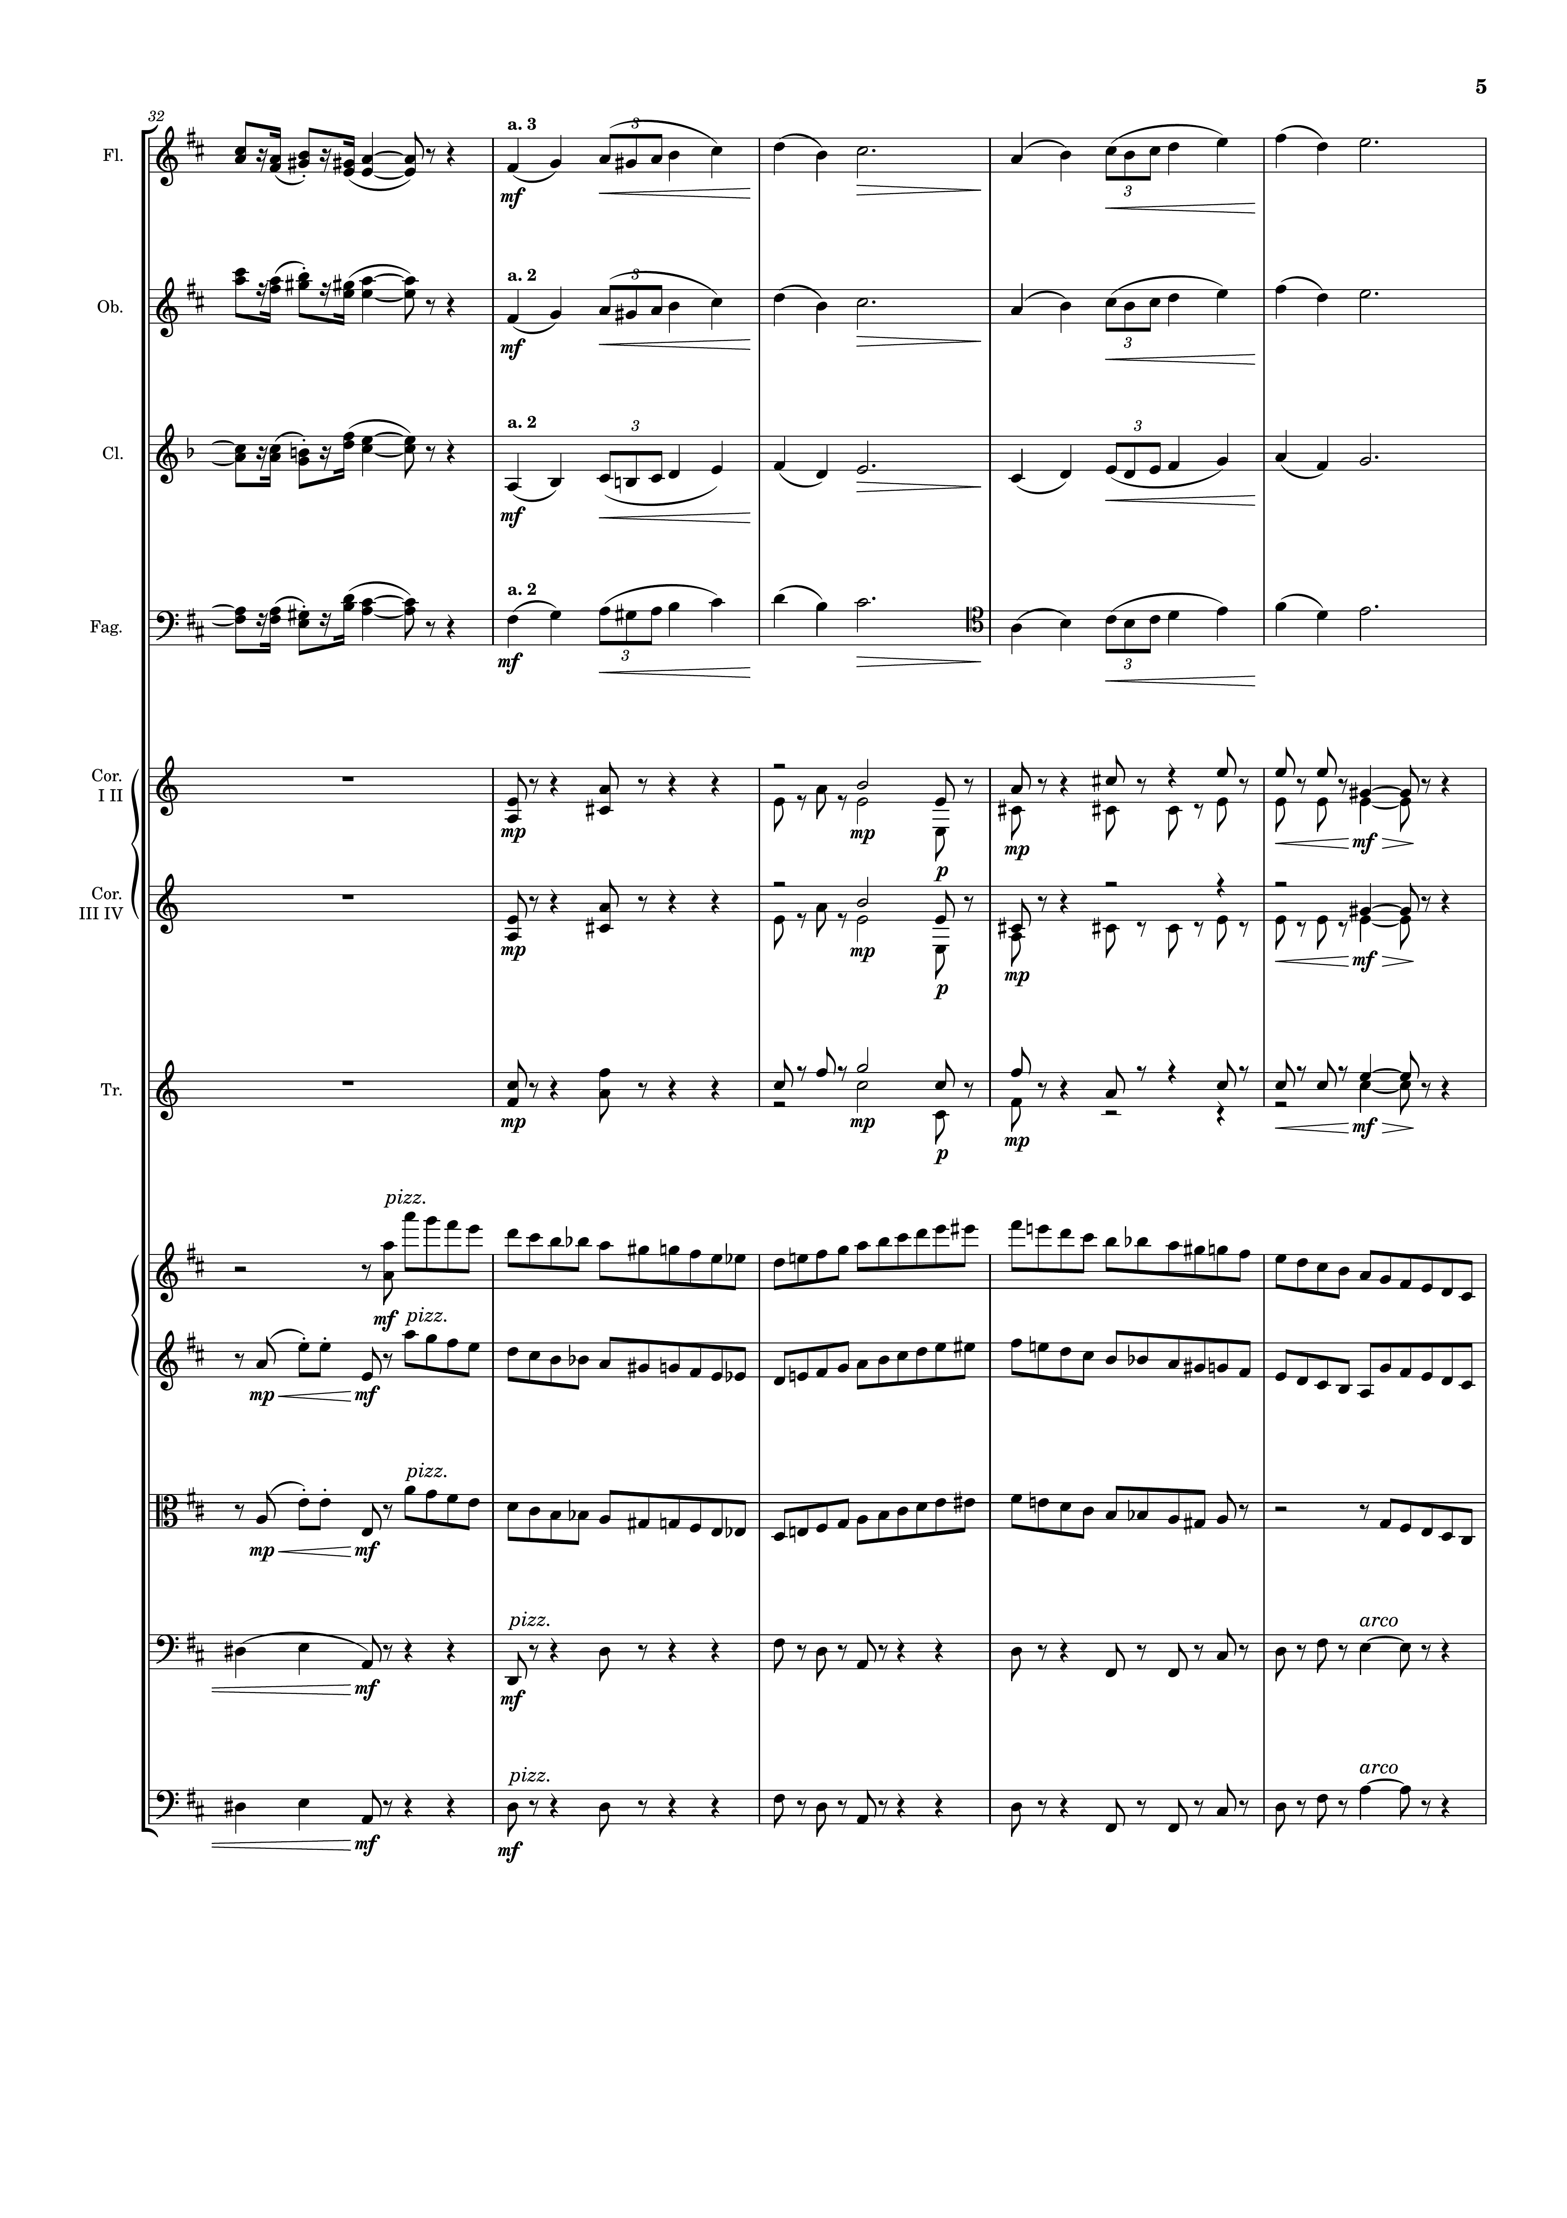
mel+rhythm
mel
mel+rhythm
mel
rhythm+harm
mel
rhythm+harm
mel
harm
harm
harm
rhythm
rhythm+harm
rhythm
rhythm+harm
rhythm
harm
harm

Slide 6
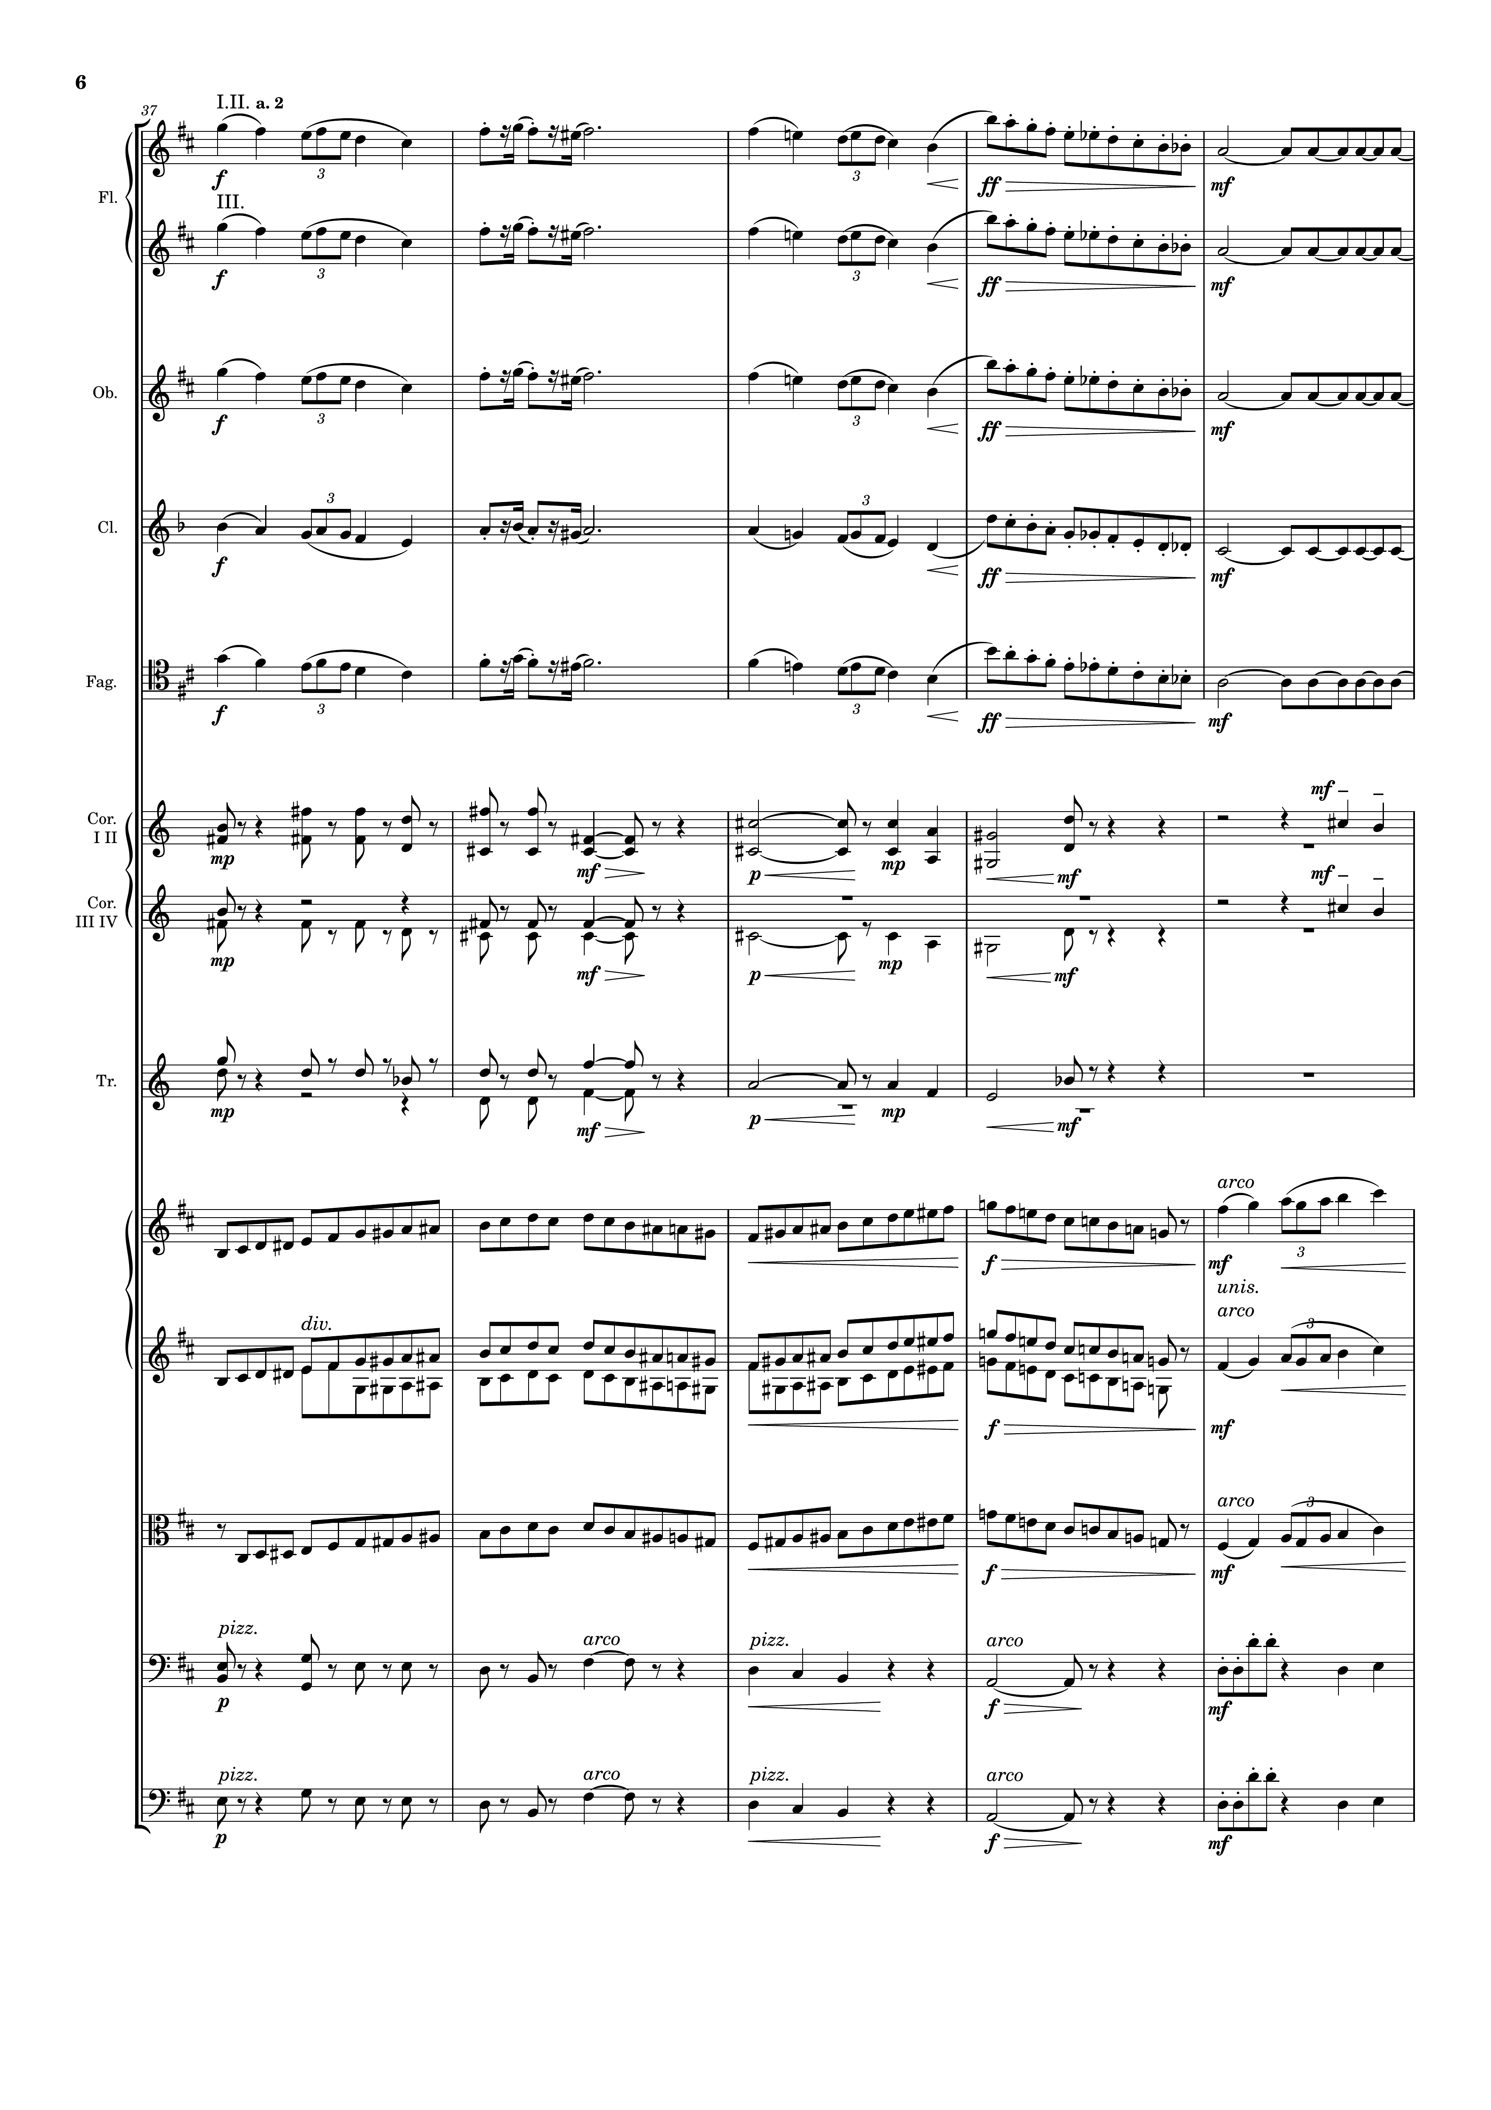
mel+rhythm
mel
rhythm
mel+rhythm
mel
rhythm
mel+rhythm
mel
rhythm
mel+rhythm
mel
rhythm
mel+rhythm
mel
rhythm
harm
harm
harm
harm
harm
rhythm
mel
rhythm
mel
rhythm
mel
harm
harm

Slide 7
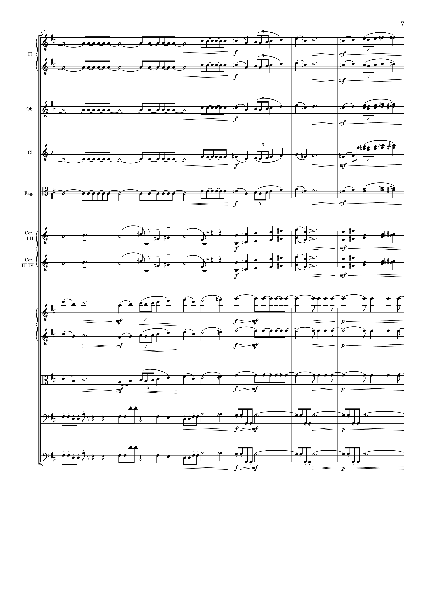
rhythm
mel
mel
rhythm
mel
rhythm
mel
rhythm
mel
rhythm
mel
harm
harm
mel
harm
harm
mel
harm
mel
rhythm
mel
rhythm
mel
rhythm
harm
rhythm
harm
rhythm

Slide 8
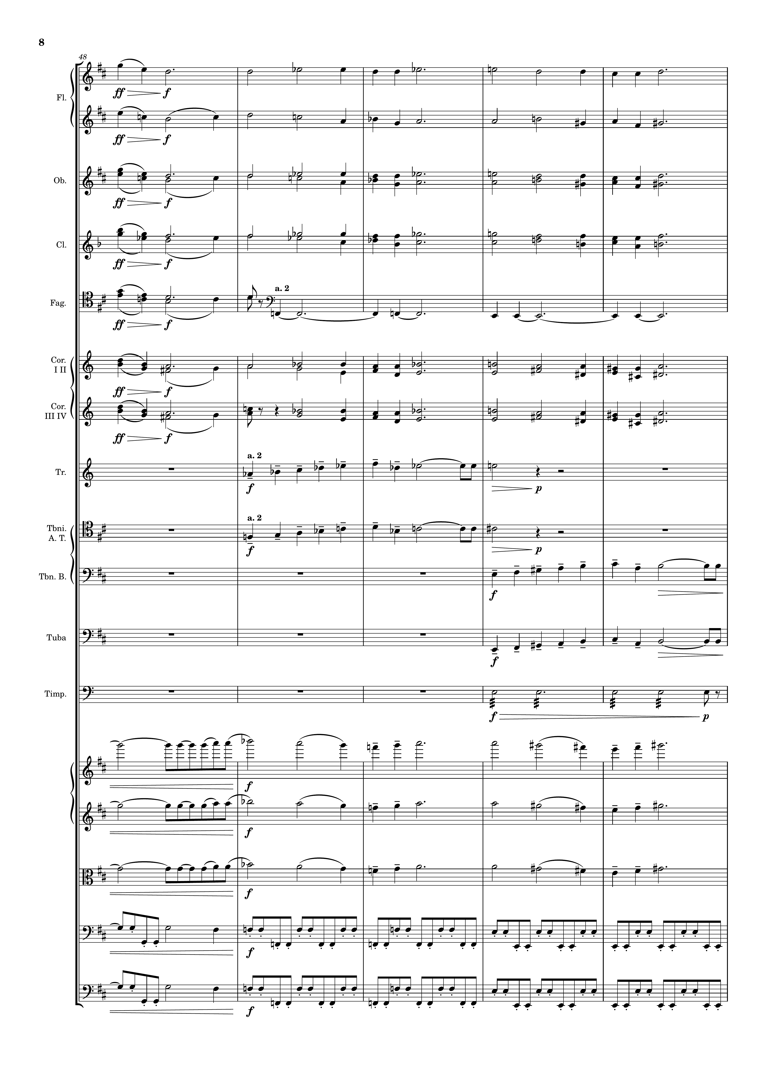
mel
harm
mel
harm
mel
harm
mel
harm
harm
mel
harm
mel
harm
mel
mel
mel
mel
rhythm
rhythm
mel
rhythm
mel
rhythm
mel
rhythm
rhythm

Slide 9
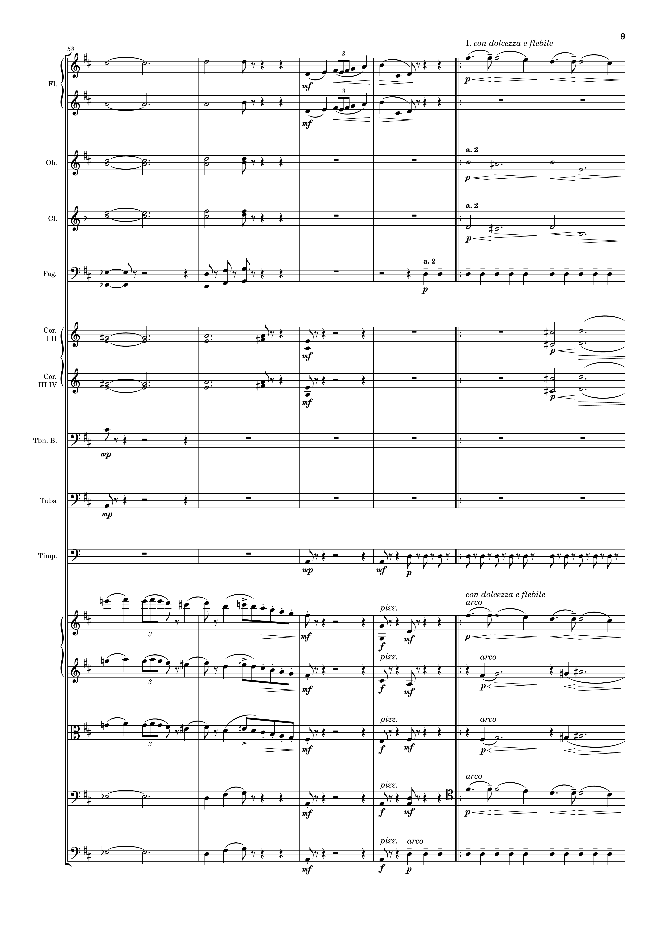
harm
mel
harm
mel
harm
harm
harm
harm
harm
rhythm
harm
harm
harm
harm
harm
harm
rhythm
mel
harm
mel
mel
harm
harm
mel
harm
harm
harm
mel
harm
rhythm

Slide 10
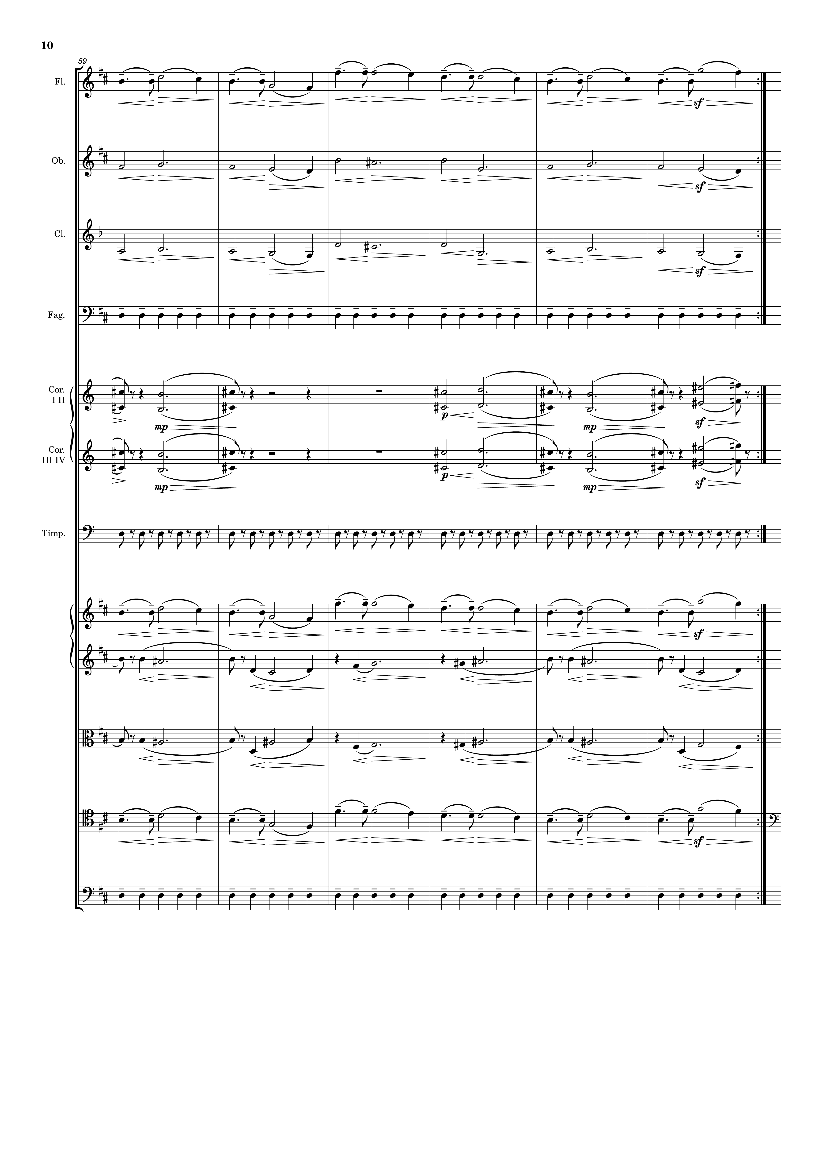
mel
harm
harm
rhythm
harm
harm
rhythm
mel
harm
harm
mel
rhythm

Slide 11
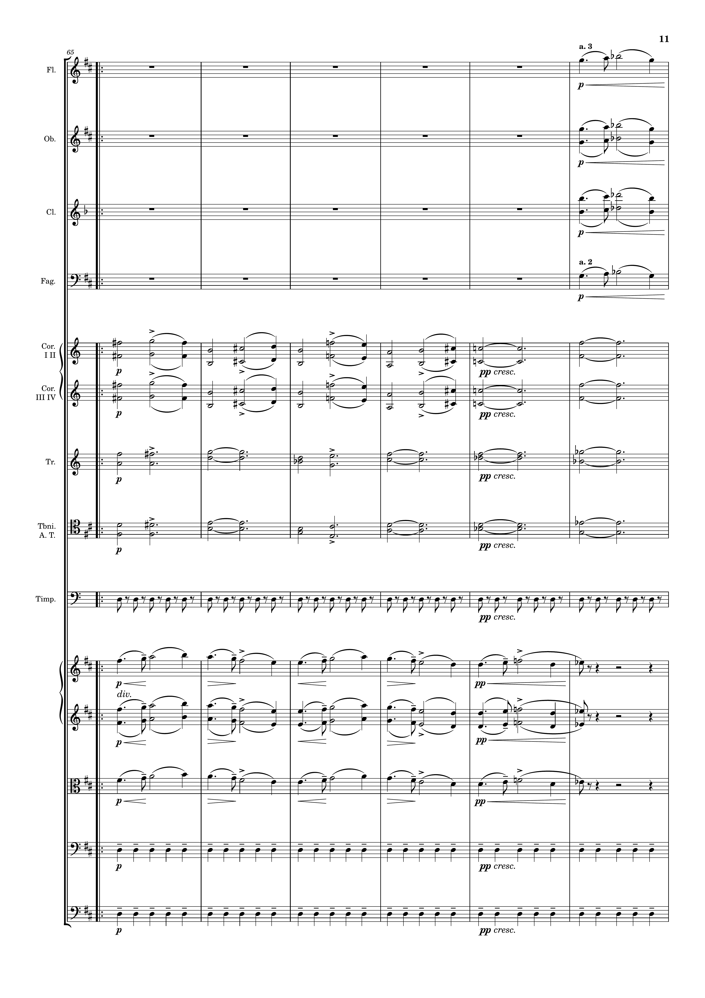
mel
mel
mel
mel
harm
harm
harm
harm
rhythm
mel
mel
mel
rhythm
rhythm

Slide 12
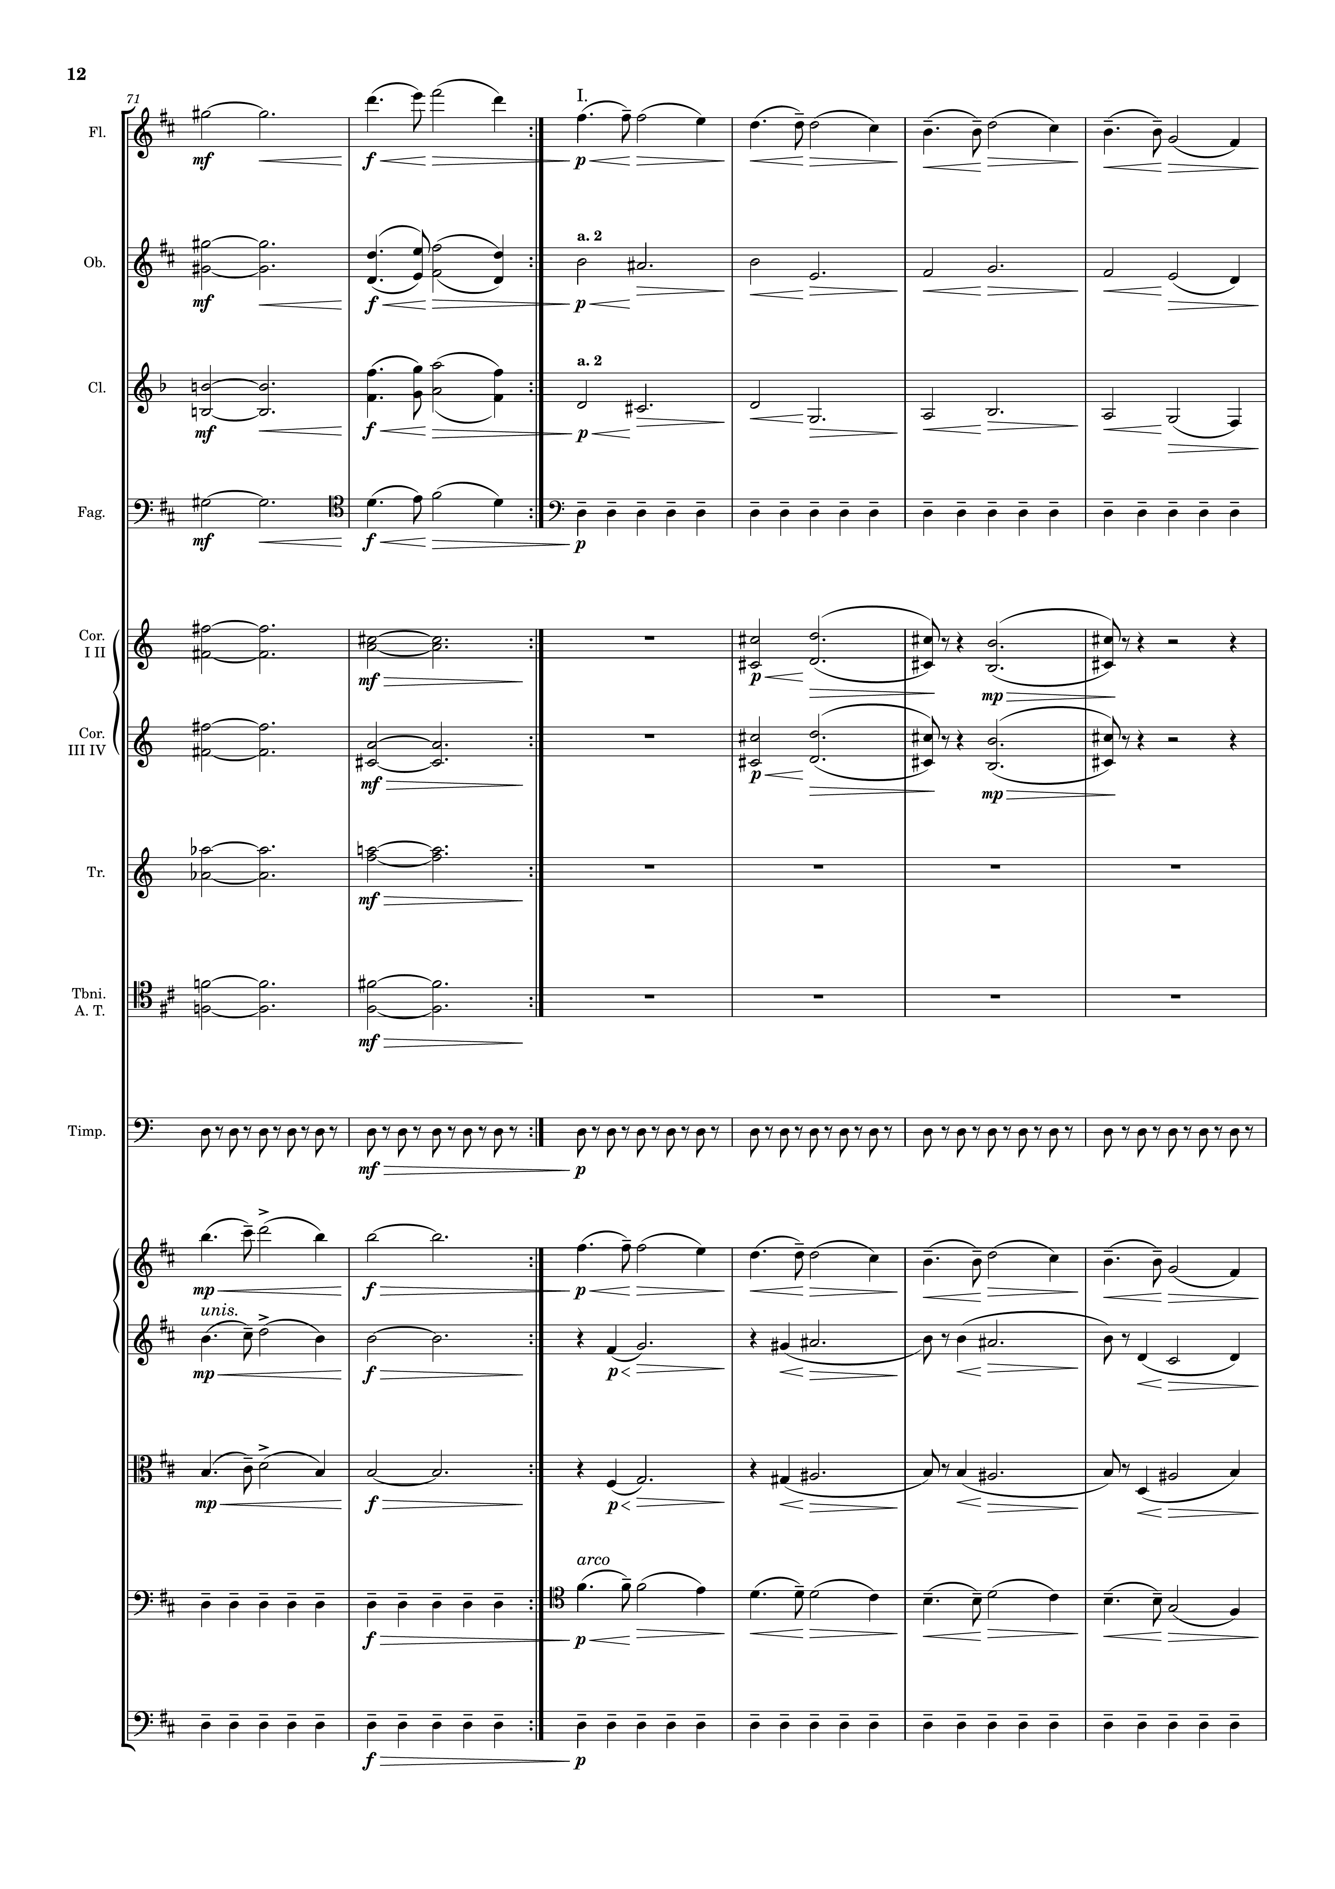
mel
mel
mel
harm
mel
harm
mel
rhythm
harm
harm
harm
harm
harm
harm
rhythm
mel
mel
harm
mel
harm
rhythm
mel
rhythm

Slide 13
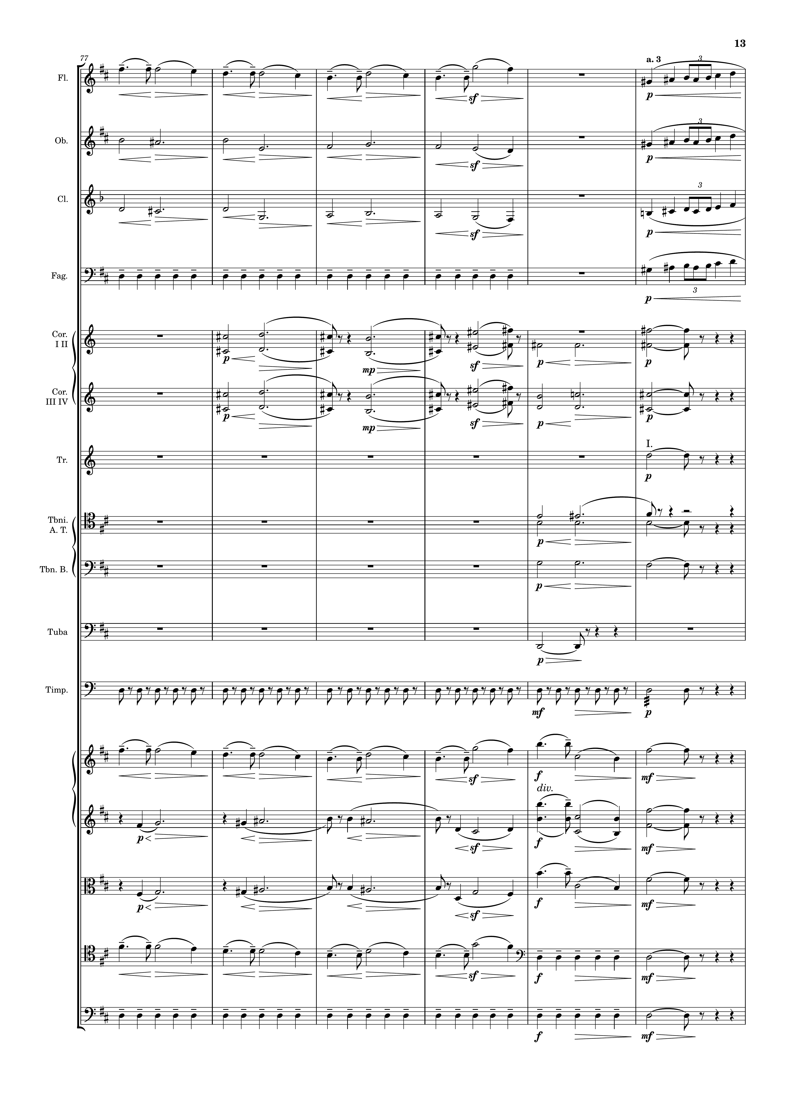
mel
mel
harm
mel
harm
mel
rhythm
mel
harm
harm
harm
harm
rhythm
mel
harm
mel
harm
mel
mel
rhythm
rhythm

Slide 14
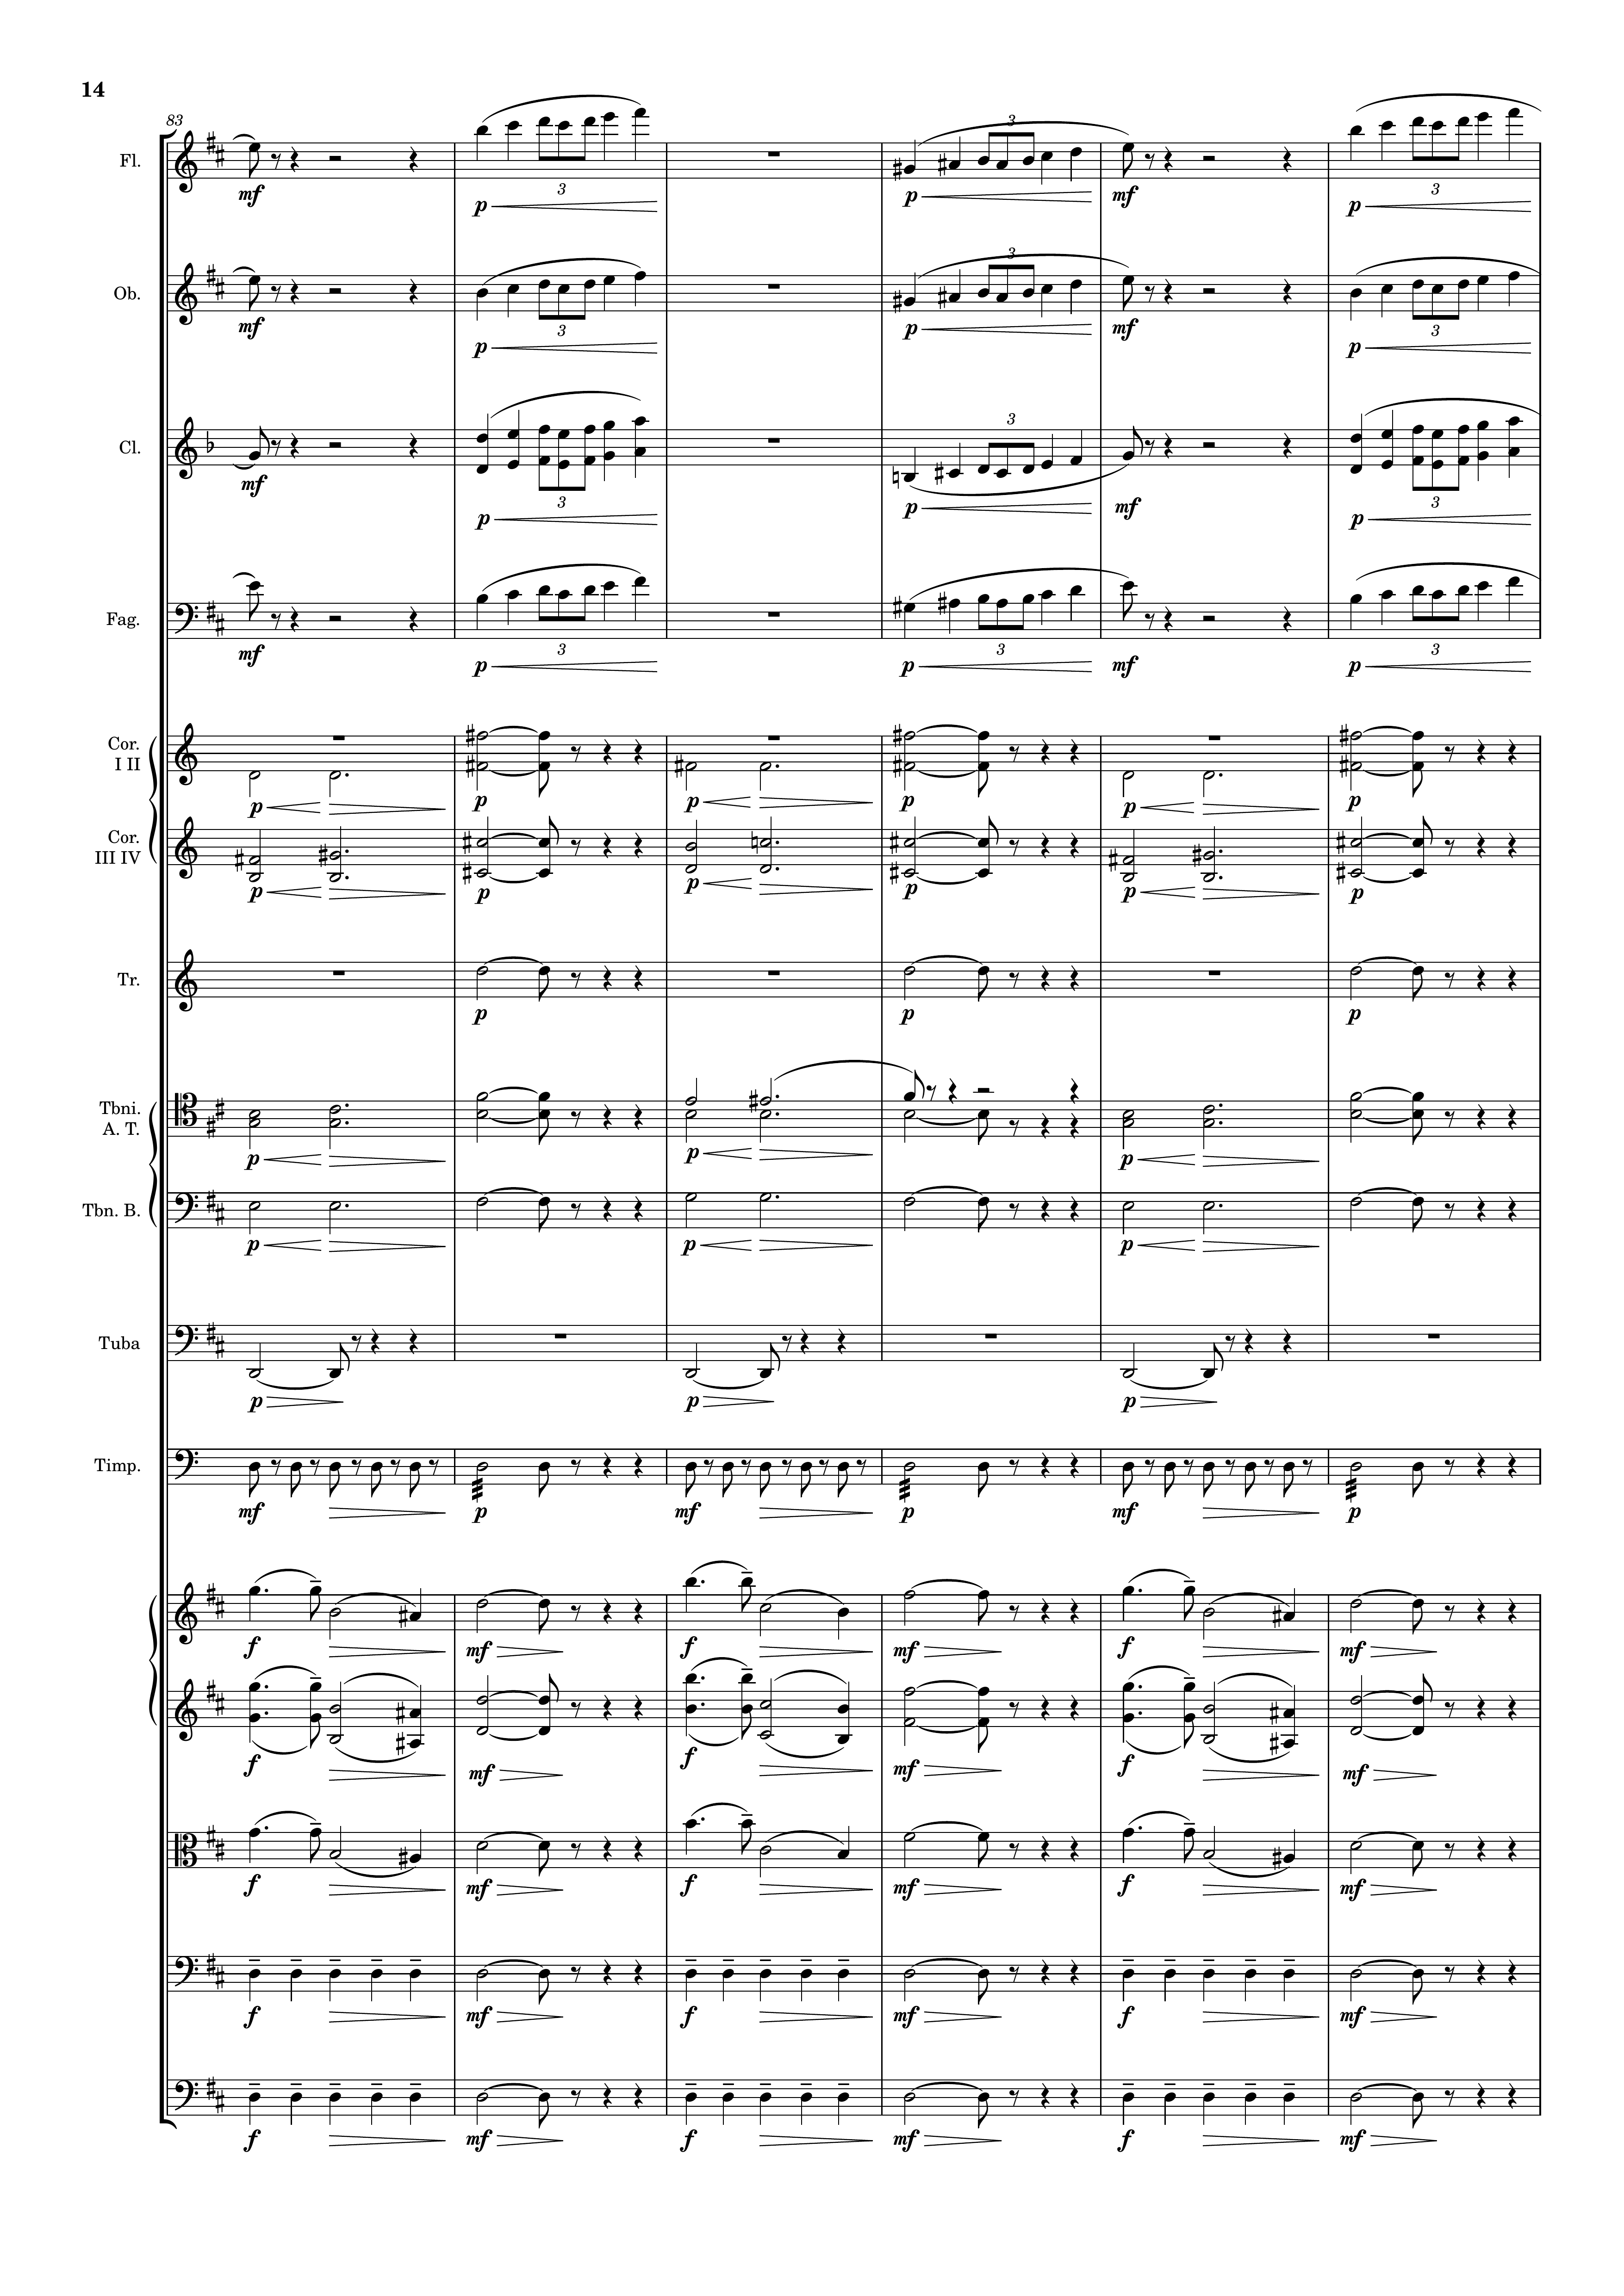
mel
mel
mel
mel
harm
harm
rhythm
harm
harm
rhythm
rhythm
mel
mel
mel
rhythm
rhythm

Slide 15
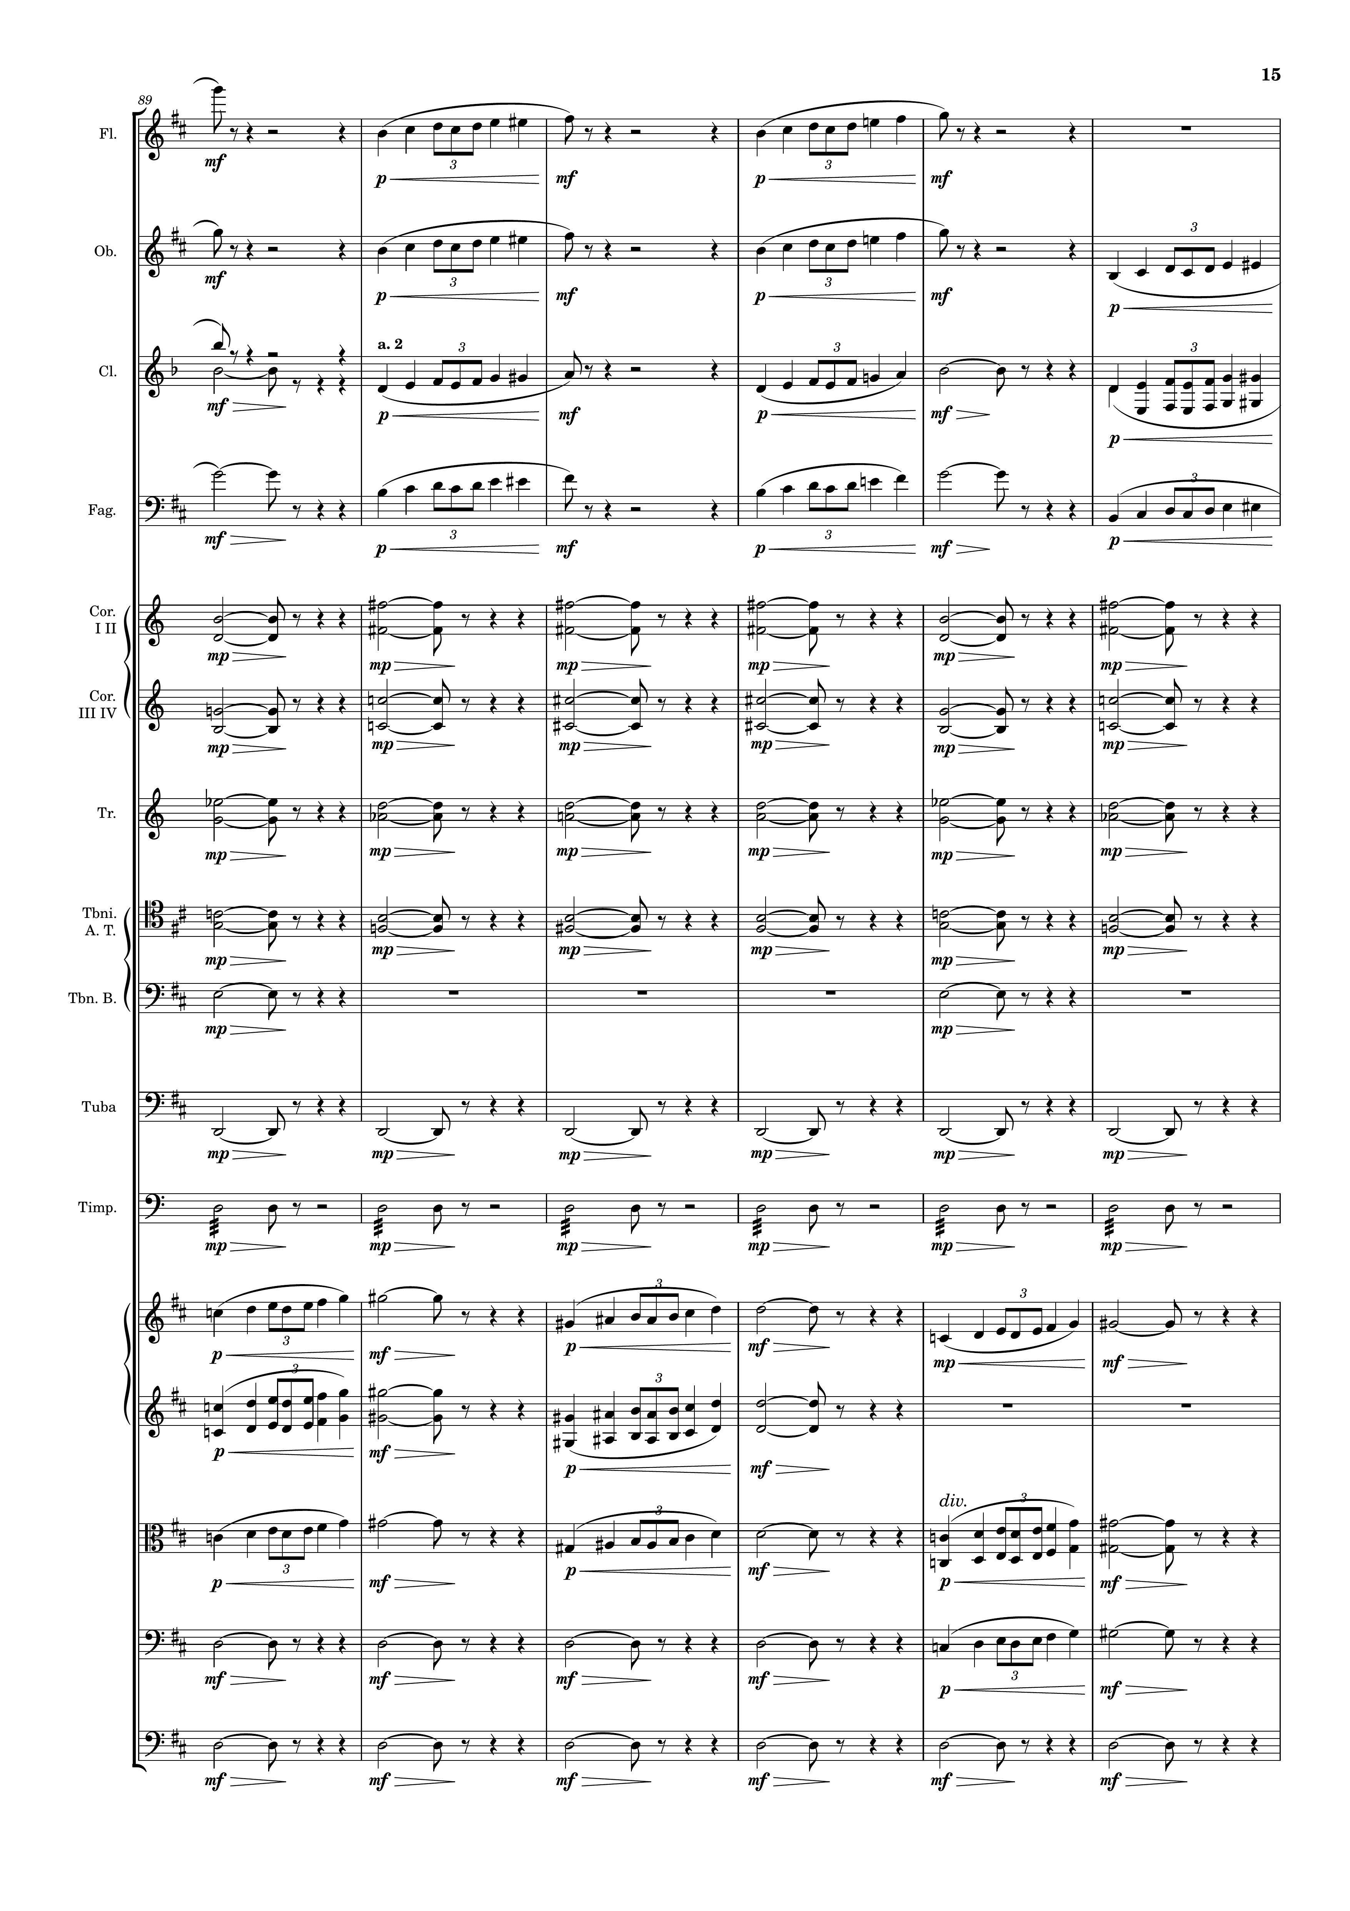
mel
mel
mel
mel
harm
harm
harm
harm
rhythm
rhythm
rhythm
mel
mel
mel
rhythm
mel
rhythm

Slide 16
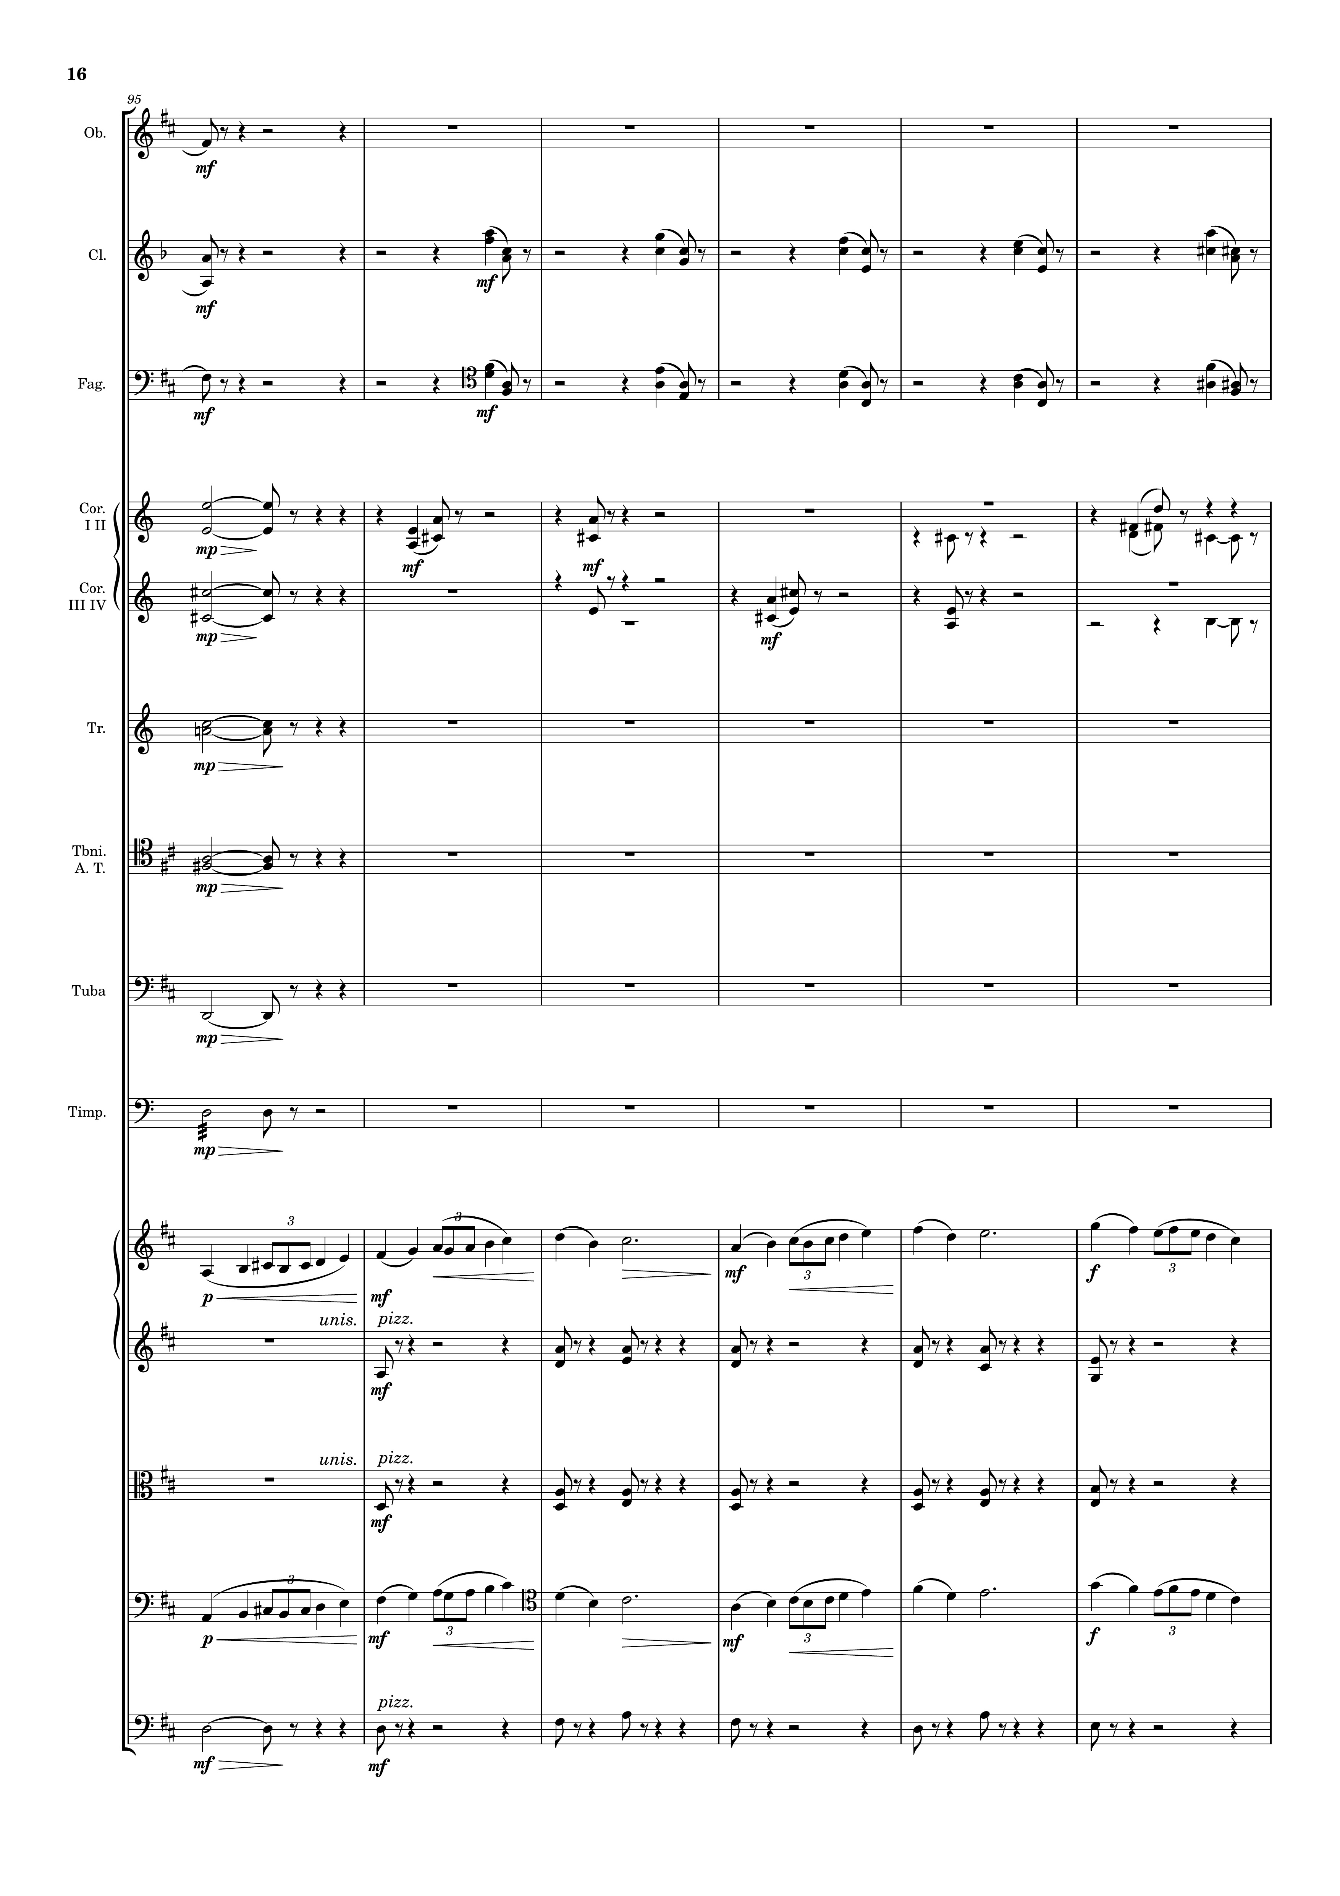
mel
mel
harm
mel
harm
harm
harm
harm
harm
rhythm
rhythm
mel
harm
harm
mel
rhythm

Slide 17
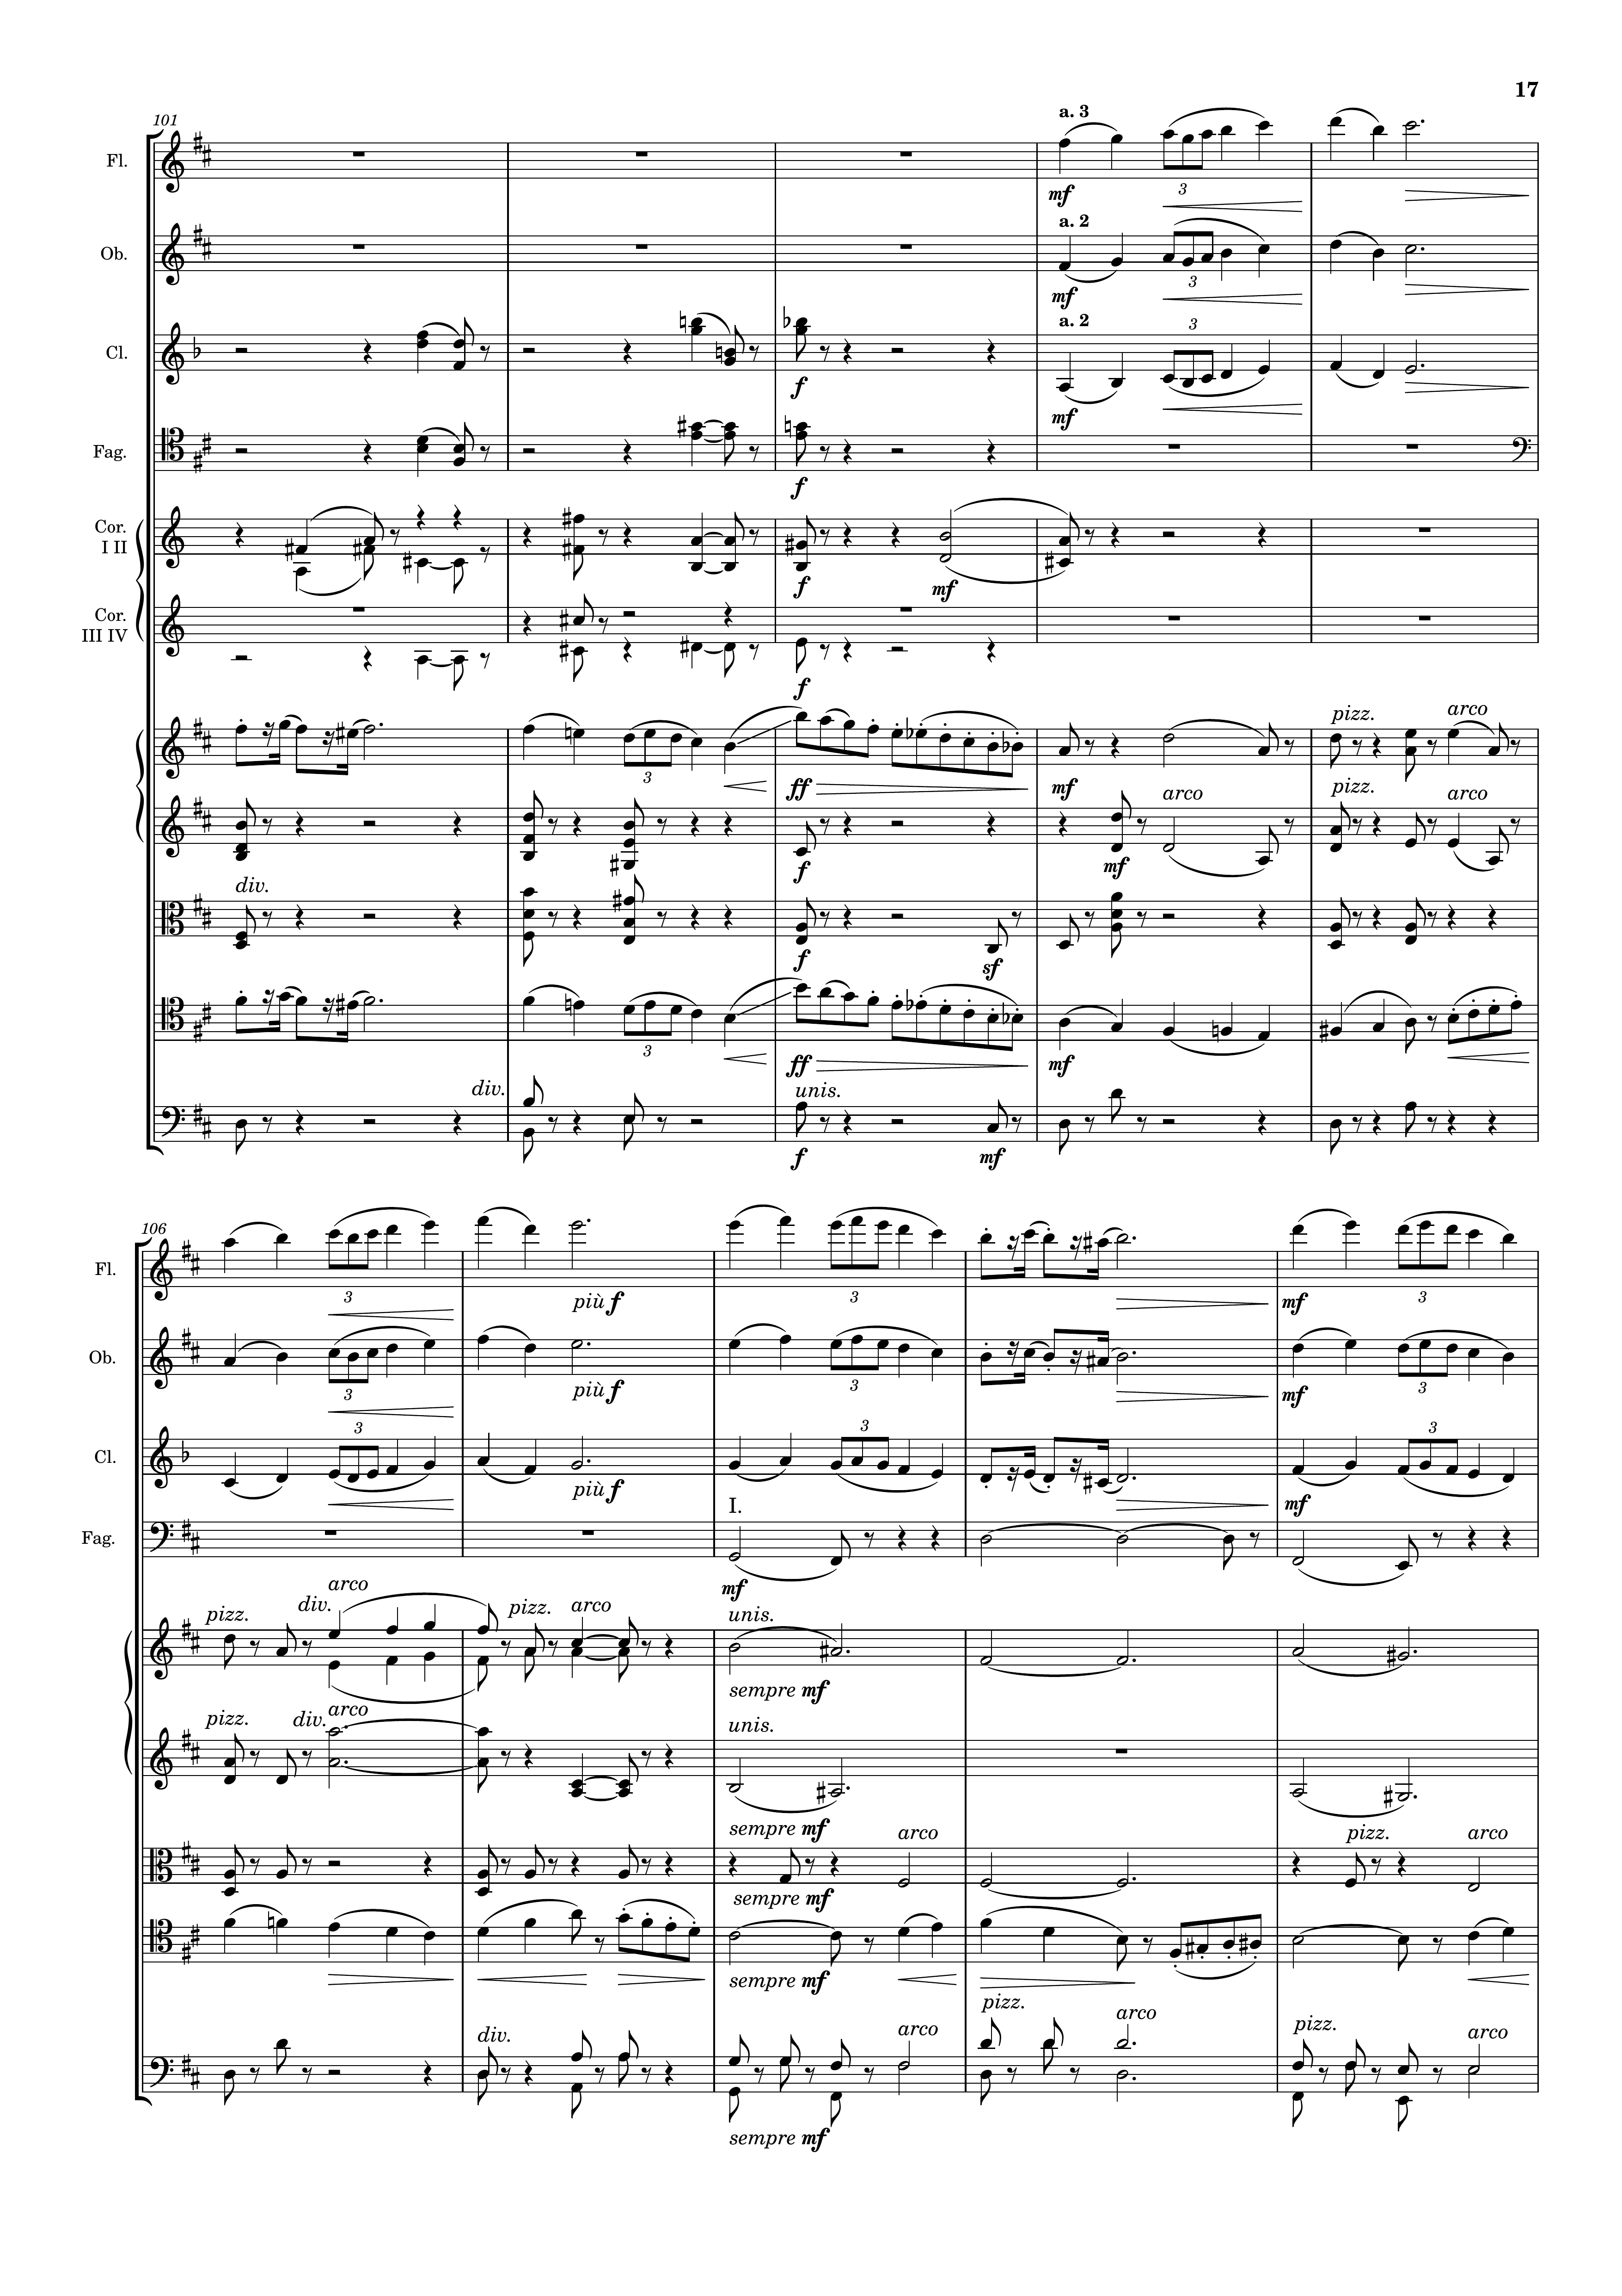
mel
mel
harm
mel
harm
harm
harm
mel
harm
harm
harm
mel
harm
harm
mel
mel+rhythm
mel
mel+rhythm
mel
mel+rhythm
harm
harm
harm
harm
harm
harm
harm

Slide 18
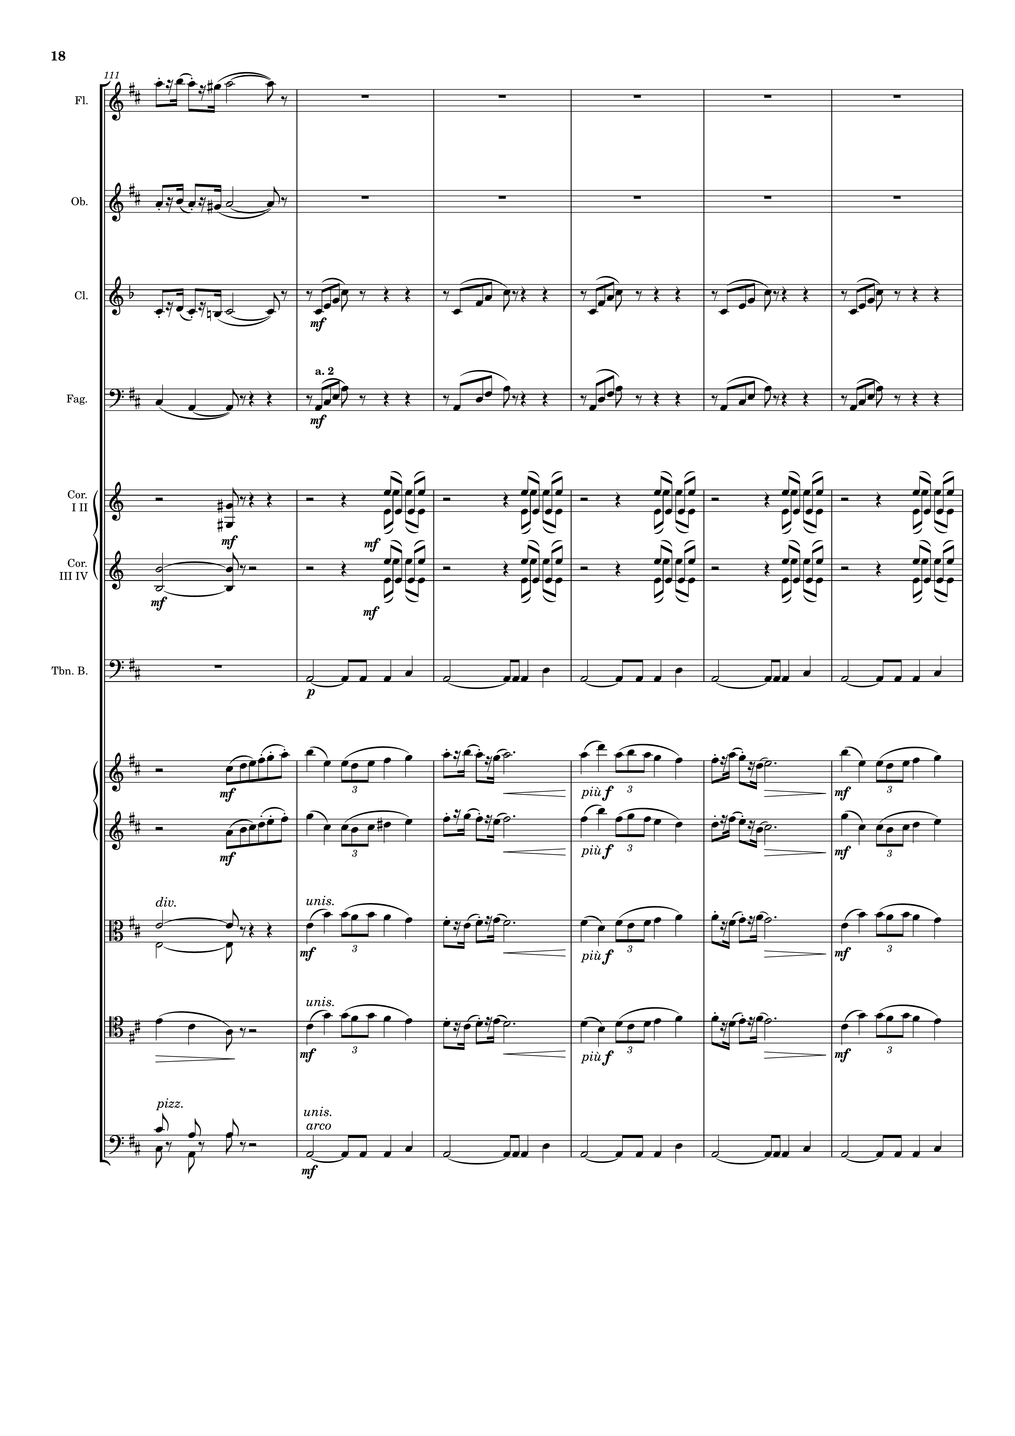
mel+rhythm
mel+rhythm
mel+rhythm
rhythm+harm
harm
rhythm+harm
harm
rhythm
harm
rhythm
harm
mel+rhythm
mel+rhythm
harm
rhythm+harm
harm
rhythm+harm
harm
harm

Slide 19
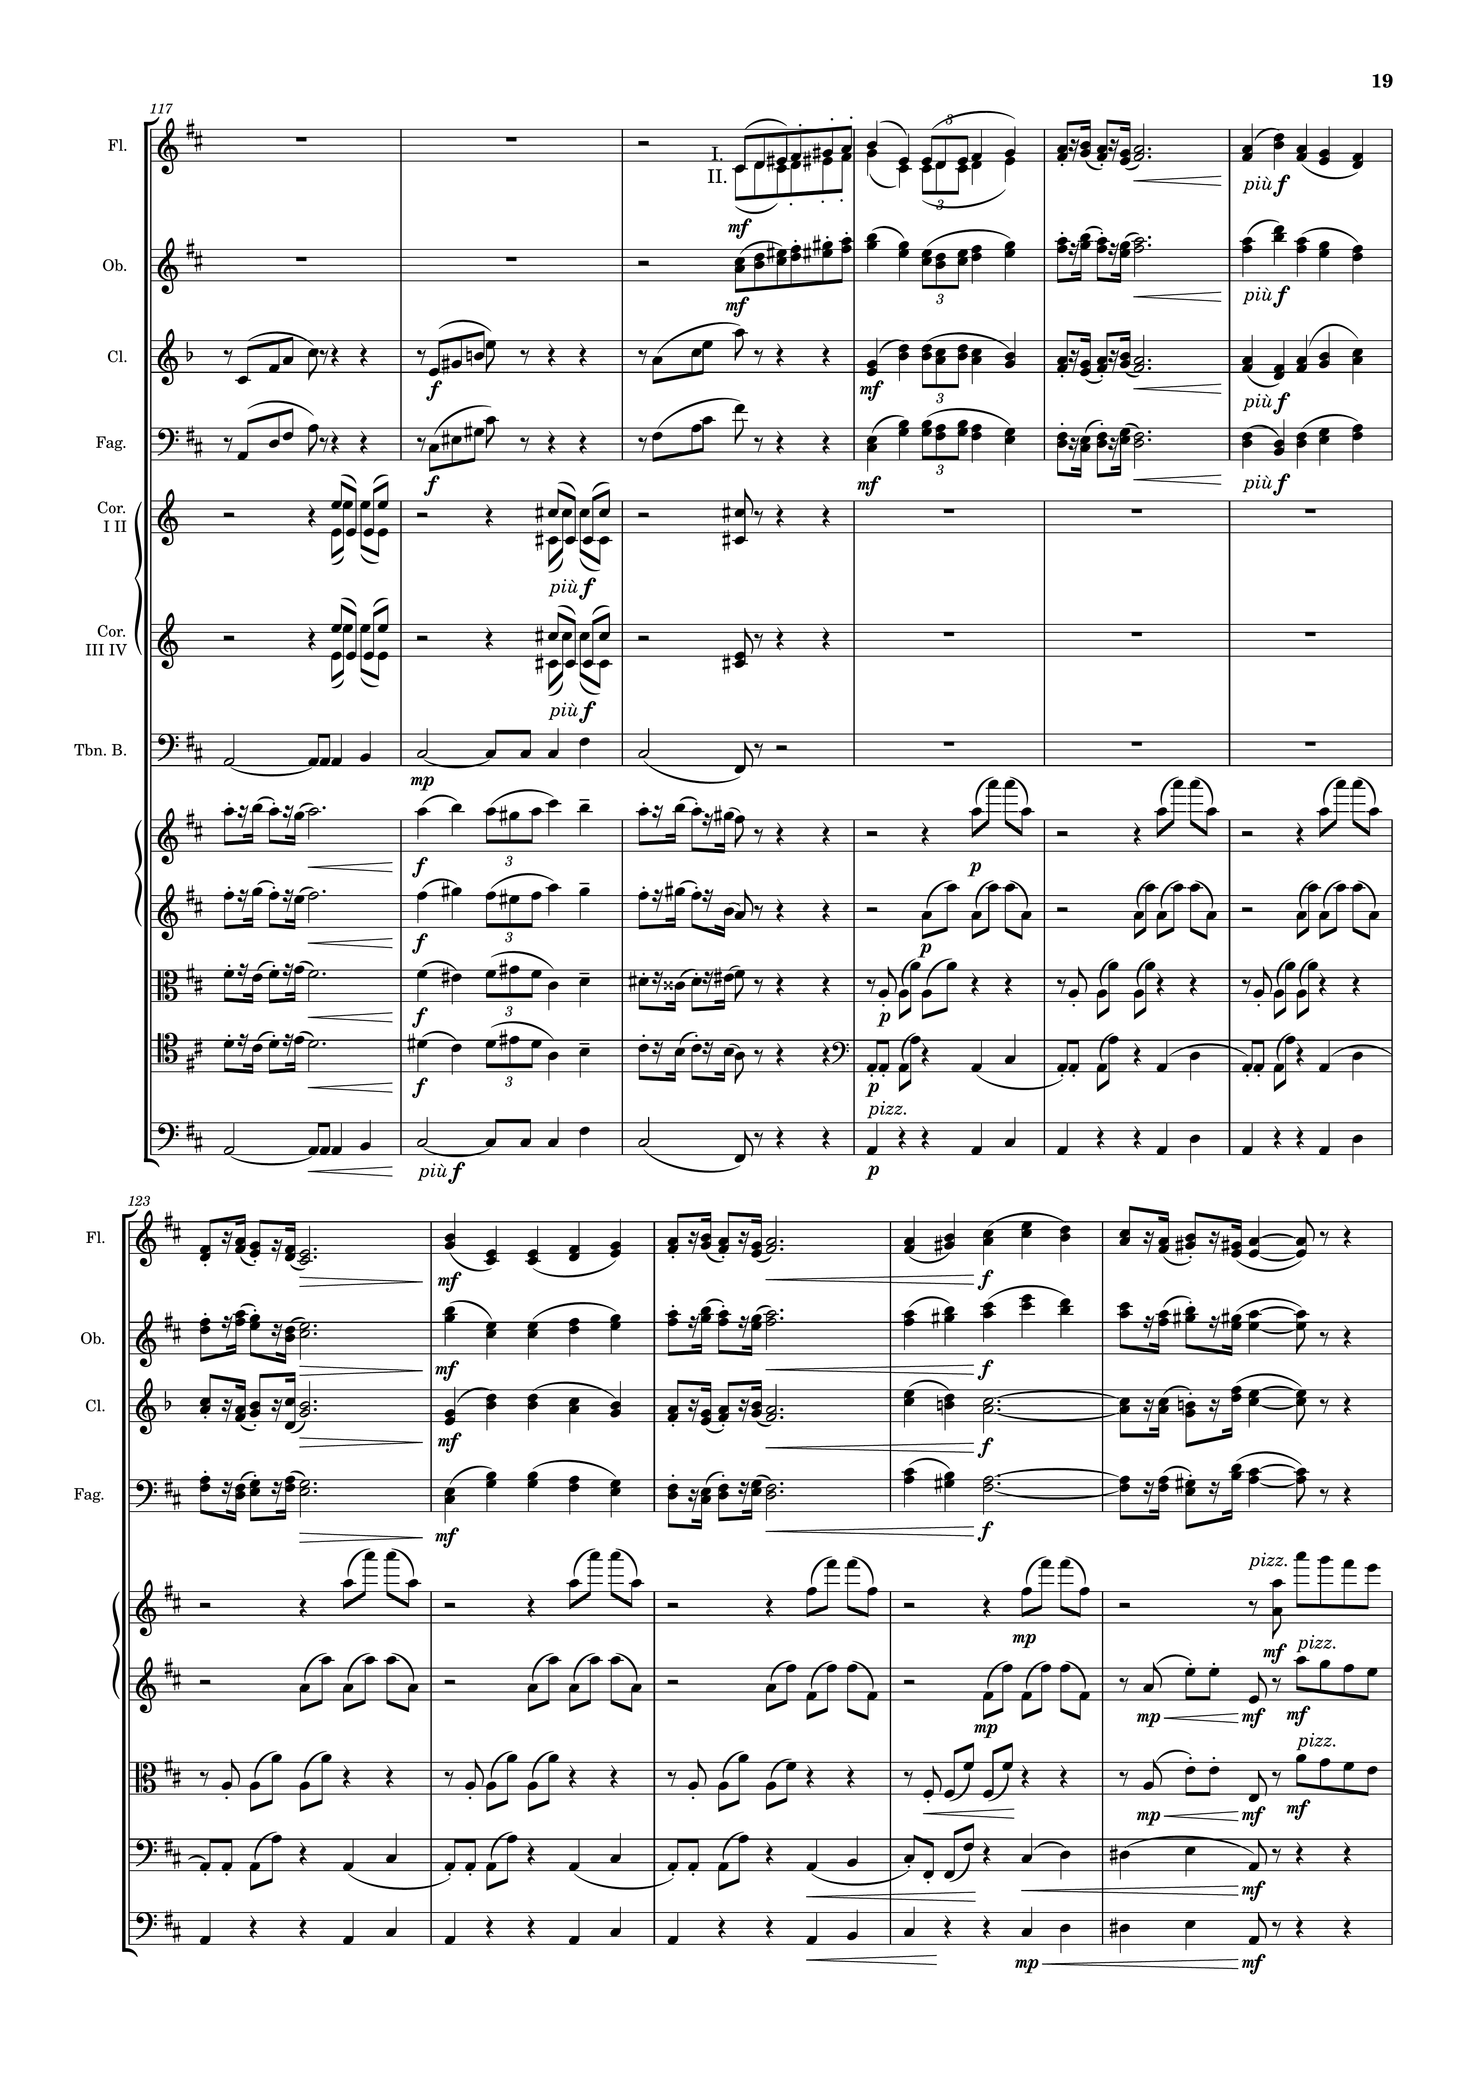
mel+rhythm
mel+rhythm
rhythm+harm
rhythm+harm
rhythm
harm
rhythm
harm
harm
mel+rhythm
rhythm
mel+rhythm
rhythm
rhythm+harm
rhythm
rhythm+harm
rhythm
harm
rhythm
mel+rhythm
mel+rhythm
rhythm+harm
rhythm+harm
rhythm
rhythm
rhythm
rhythm
harm
rhythm
harm

Slide 20
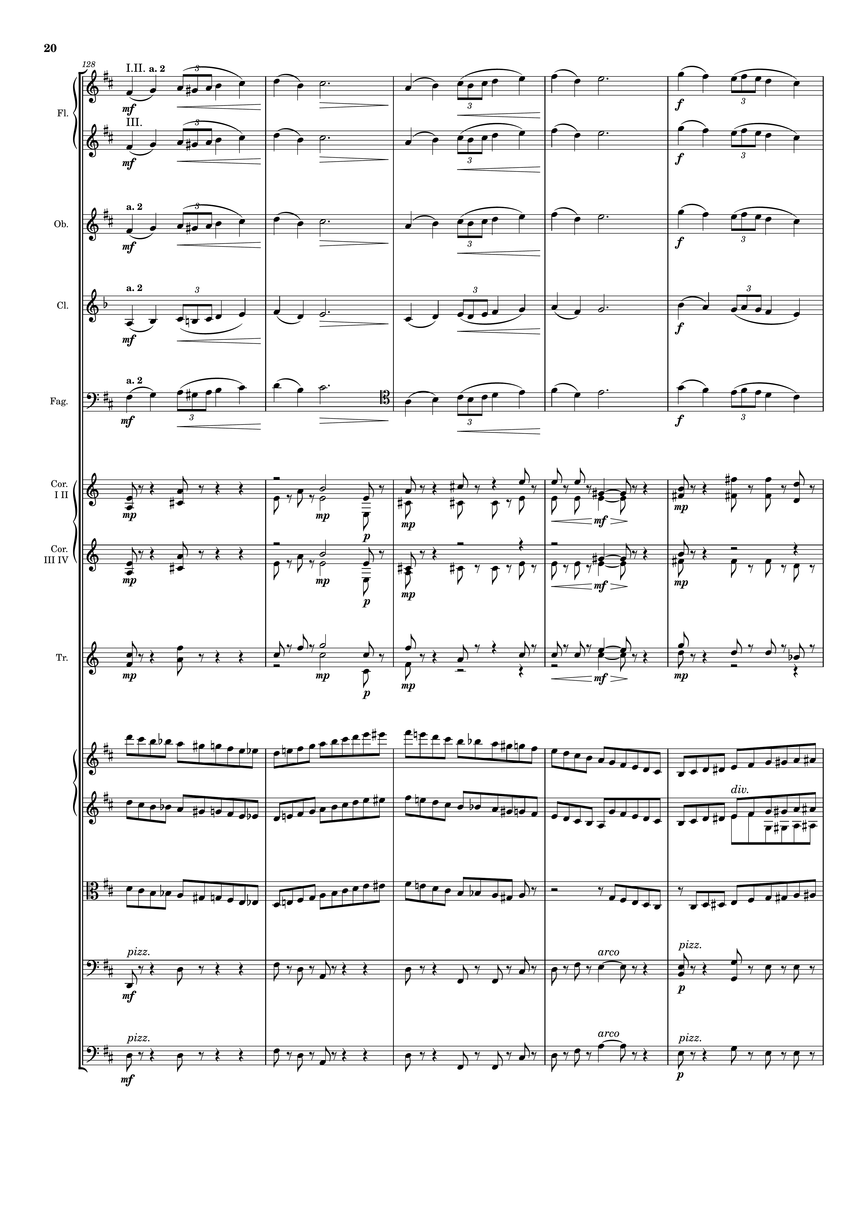
mel
mel+rhythm
mel
mel+rhythm
mel
mel+rhythm
mel
mel+rhythm
mel
mel+rhythm
harm
harm
harm
rhythm
rhythm
rhythm
harm
harm

Slide 21
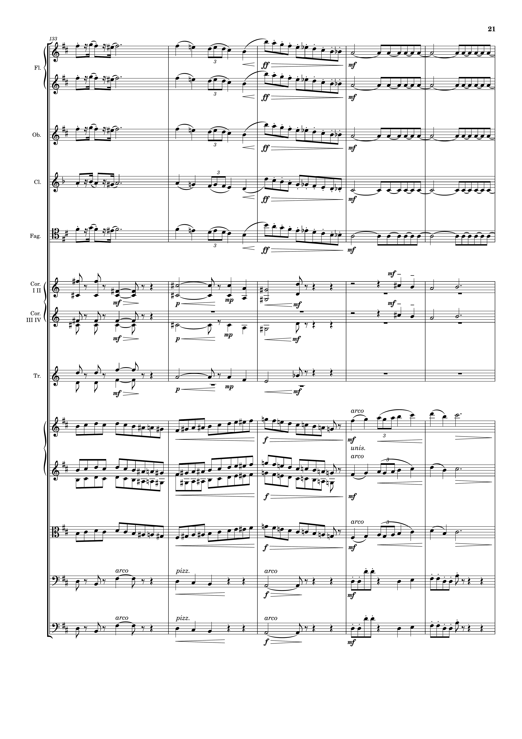
mel+rhythm
mel
rhythm
mel+rhythm
mel
rhythm
mel+rhythm
mel
rhythm
mel+rhythm
mel
rhythm
mel+rhythm
mel
rhythm
harm
harm
harm
harm
harm
rhythm
mel
mel
rhythm
mel
rhythm
harm
harm

Slide 22
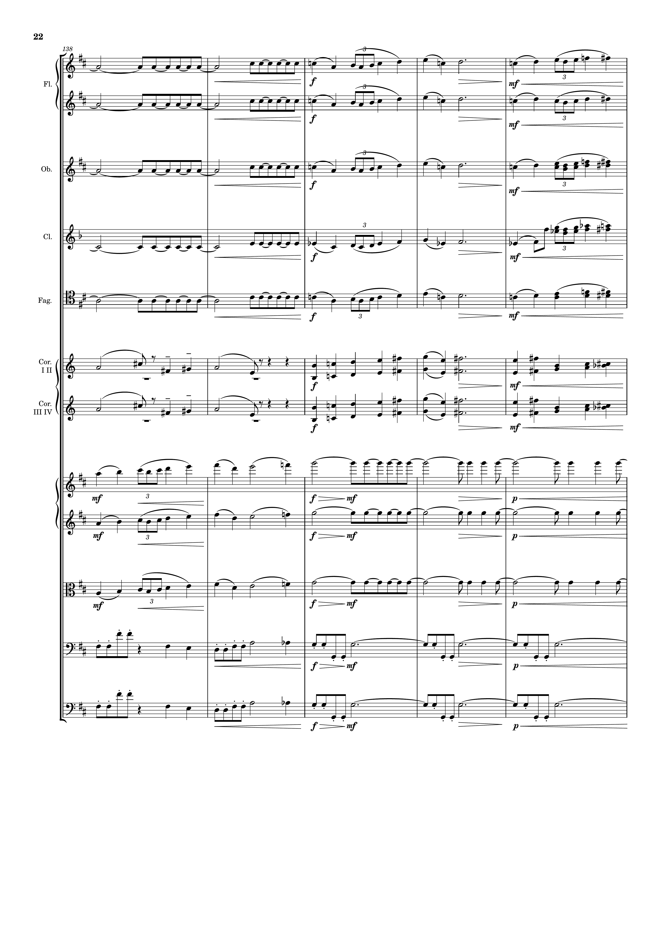
rhythm
mel
rhythm
mel
rhythm
mel
rhythm
mel
rhythm
mel
harm
mel
harm
harm
harm
mel
rhythm
mel
rhythm
mel
rhythm
harm
rhythm
harm
rhythm

Slide 23
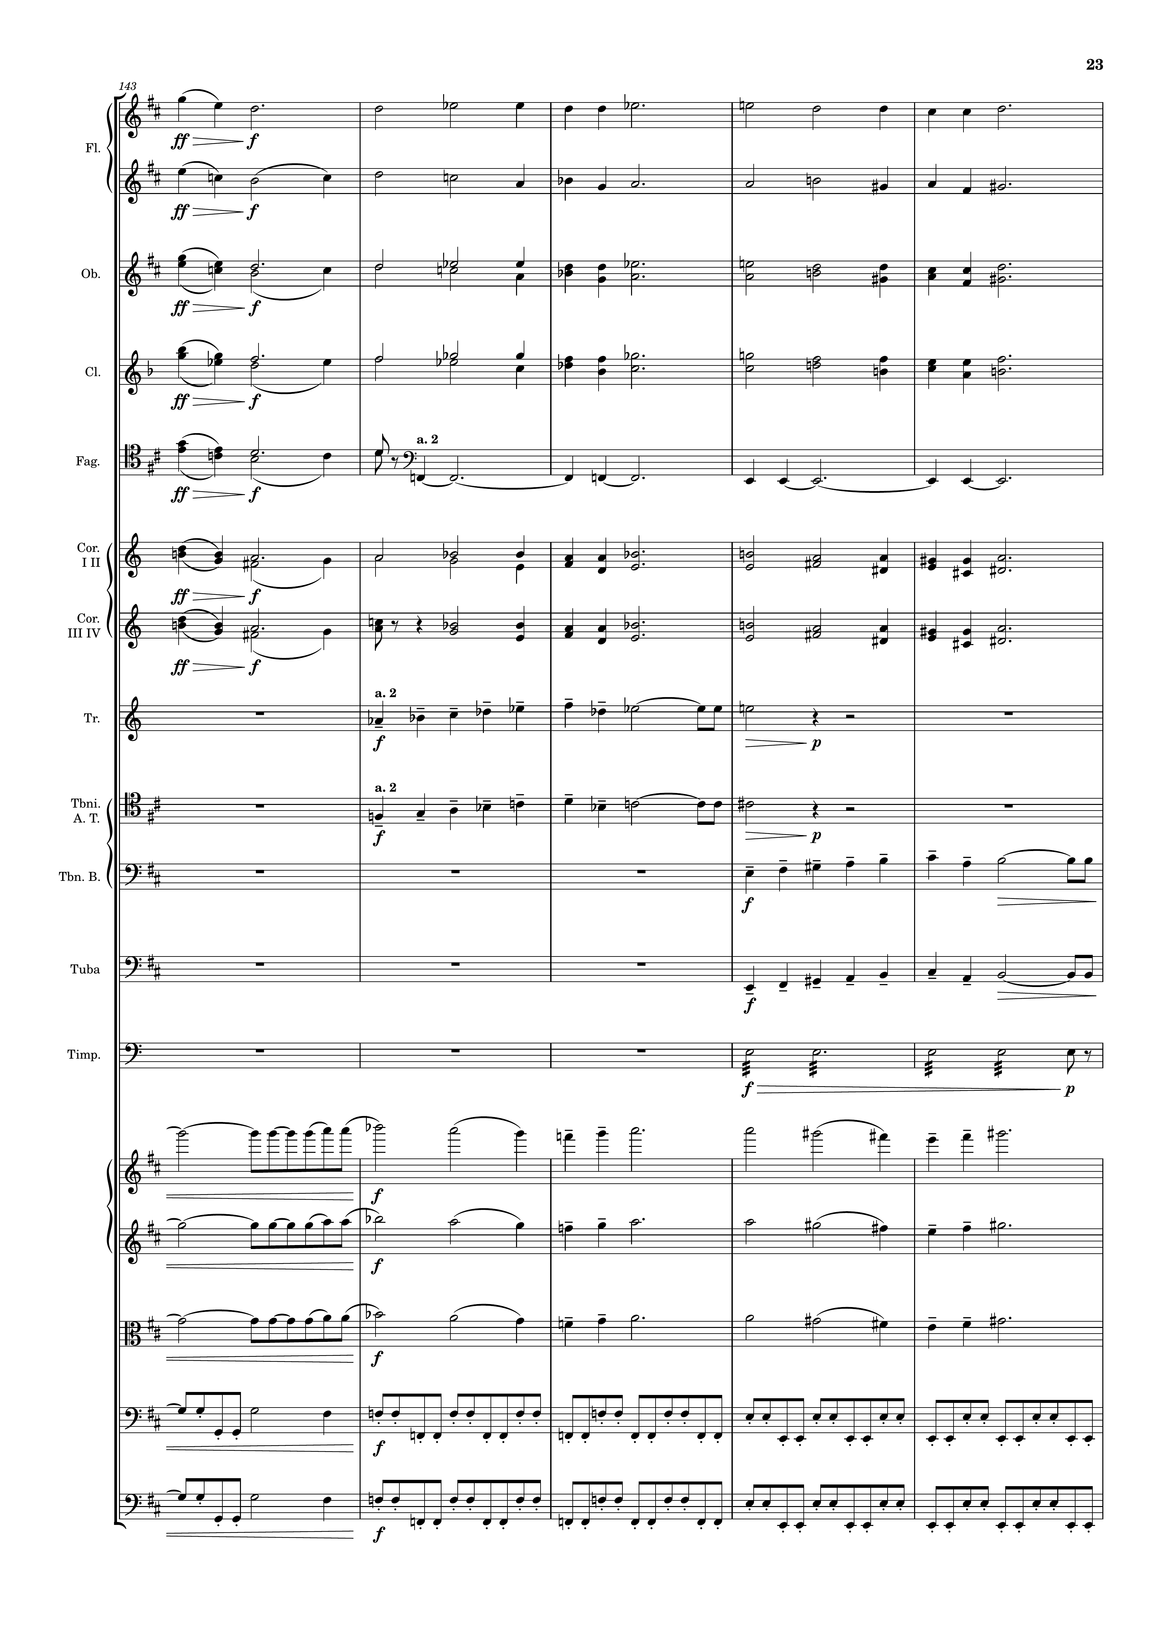
mel
harm
mel
harm
mel
harm
mel
harm
mel
rhythm
harm
harm
mel
mel
mel
mel
rhythm
rhythm
mel
rhythm
mel
rhythm
mel
rhythm
rhythm

Slide 24
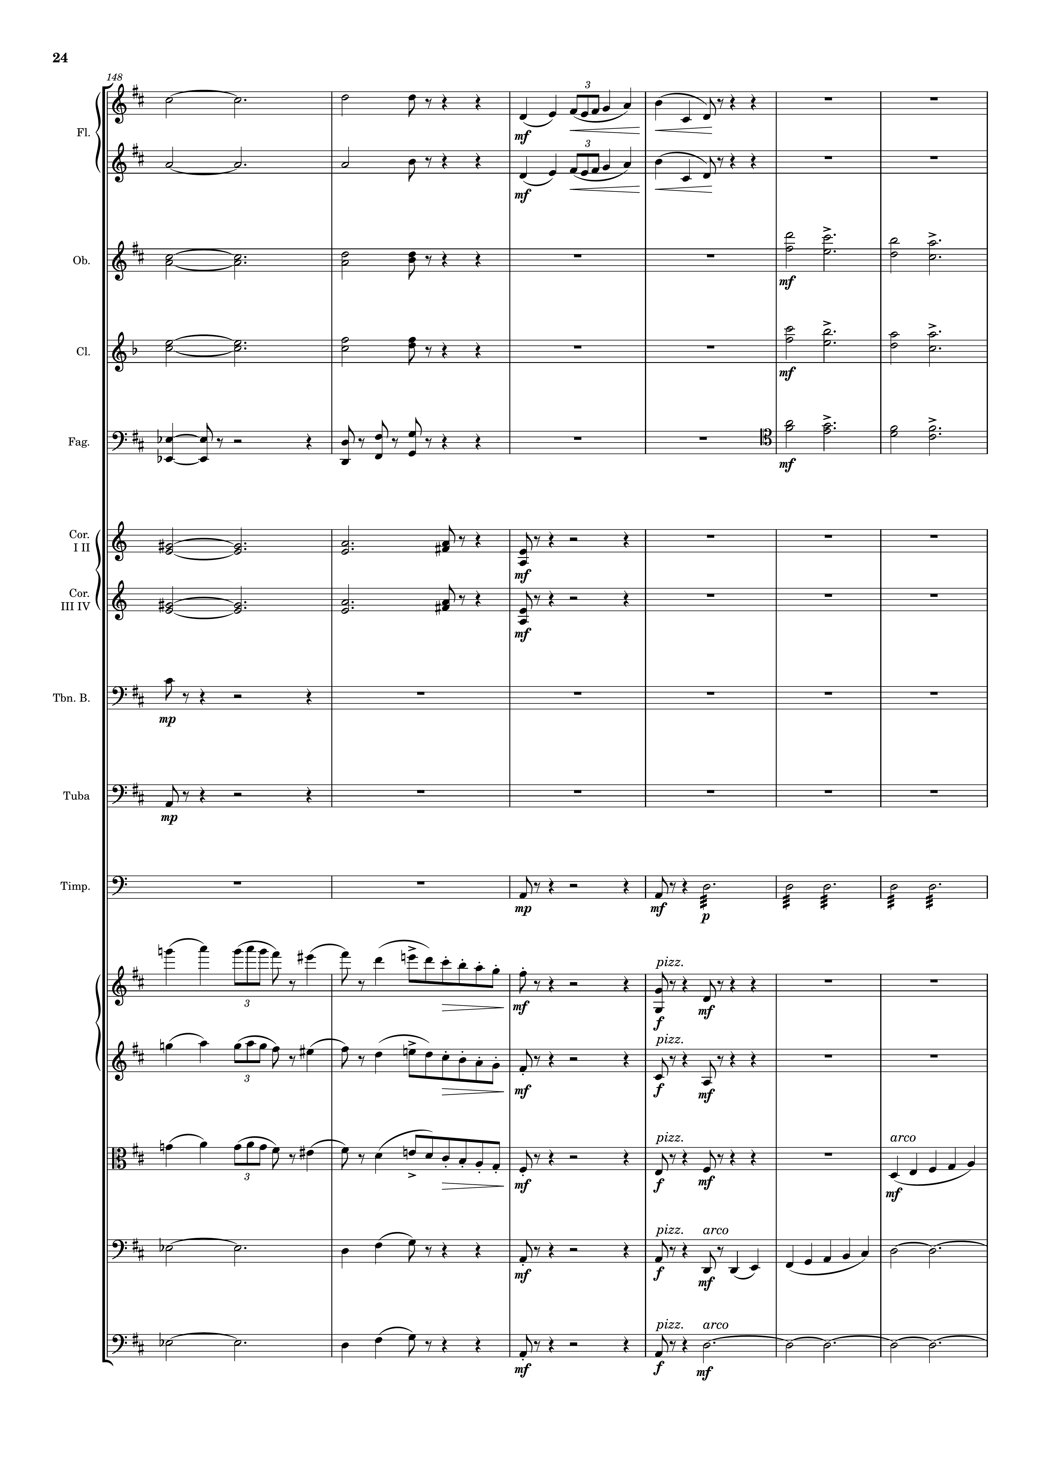
harm
mel
harm
mel
harm
mel
harm
mel
harm
harm
harm
harm
mel
mel
rhythm
mel
harm
mel
harm
mel
harm
harm
harm
rhythm
harm
harm
rhythm

Slide 25
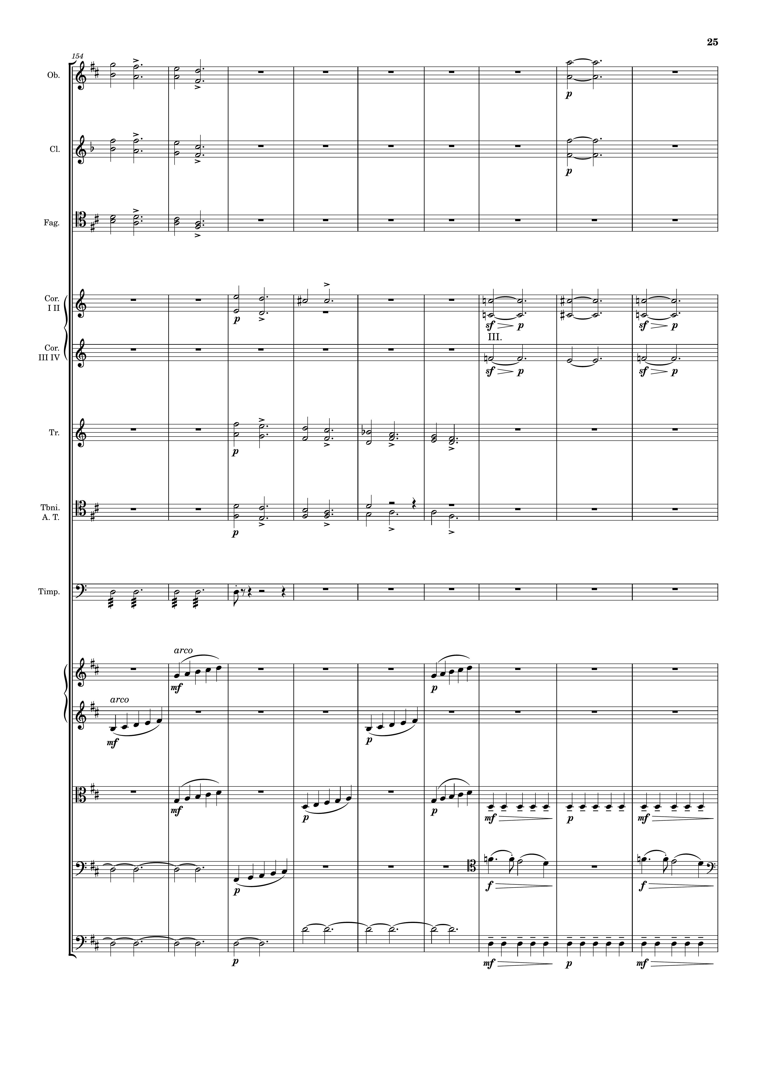
mel
harm
harm
harm
harm
mel
harm
harm
mel
mel
rhythm
harm
harm
harm
rhythm
rhythm
harm
mel
rhythm

Slide 26
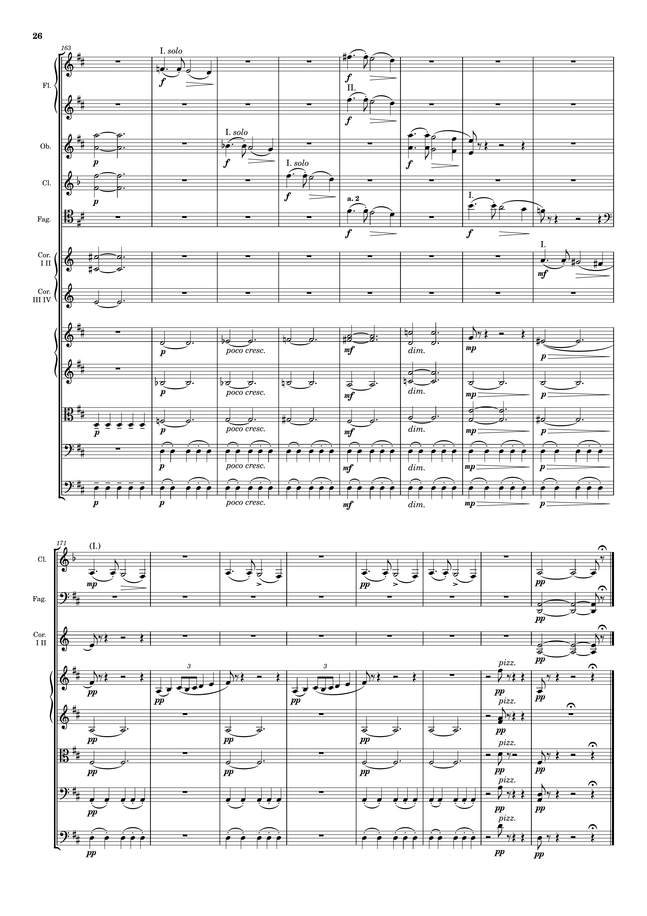
mel
mel
harm
mel
harm
mel
mel
harm
mel
harm
harm
harm
rhythm
harm
rhythm
rhythm
mel
harm
harm
mel
harm
mel
harm
rhythm
harm
rhythm
harm
rhythm
harm
rhythm
harm

